Slide 1
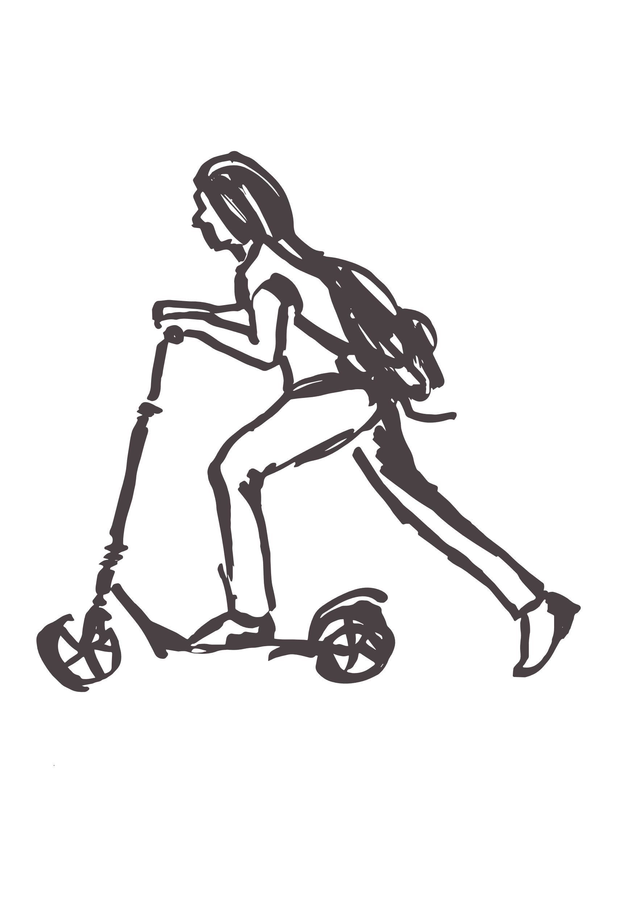
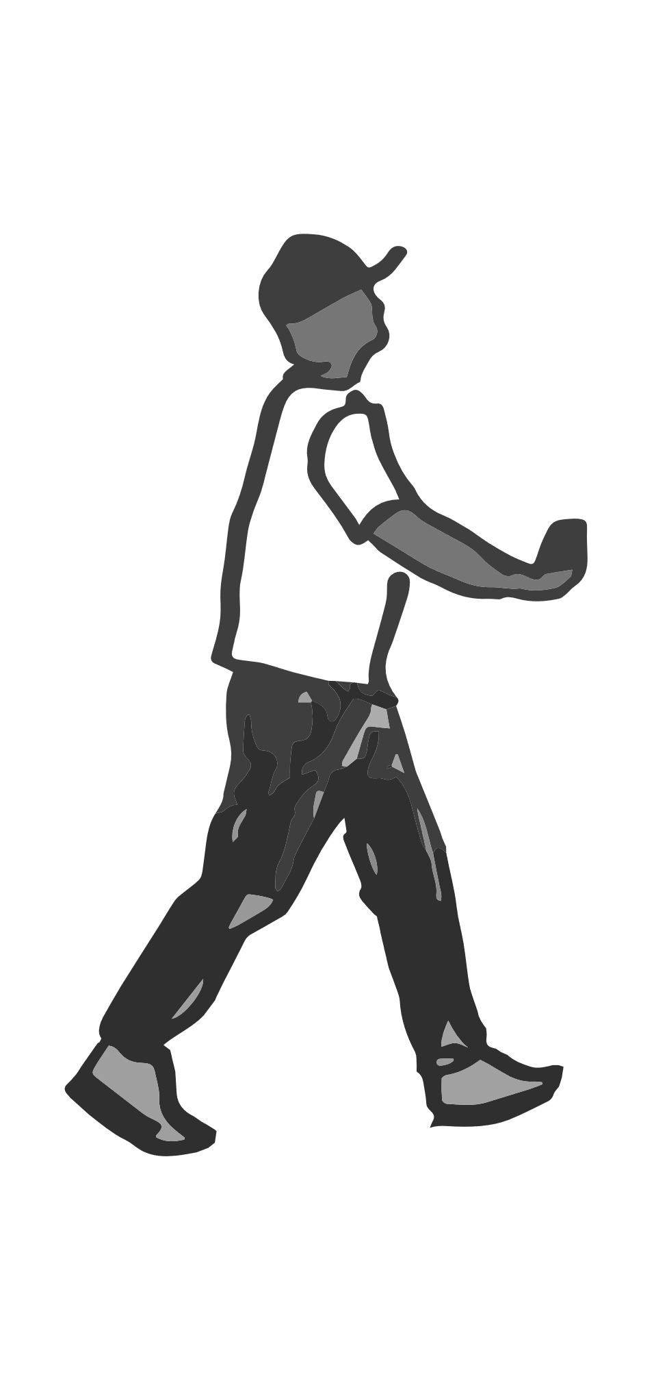
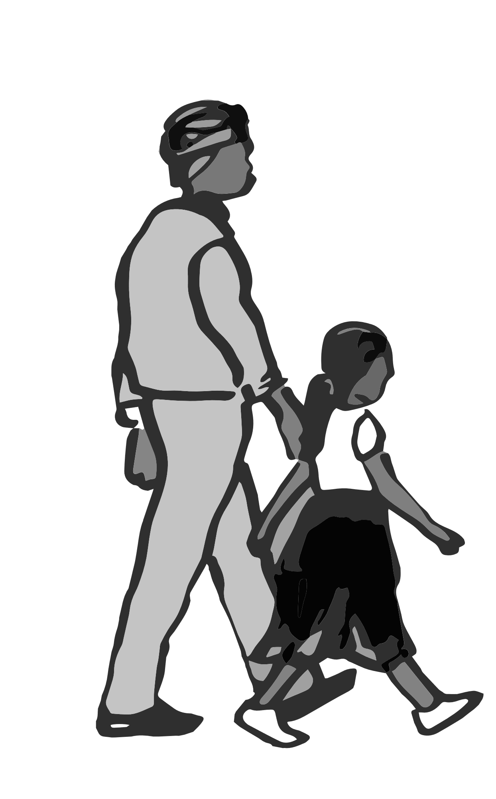
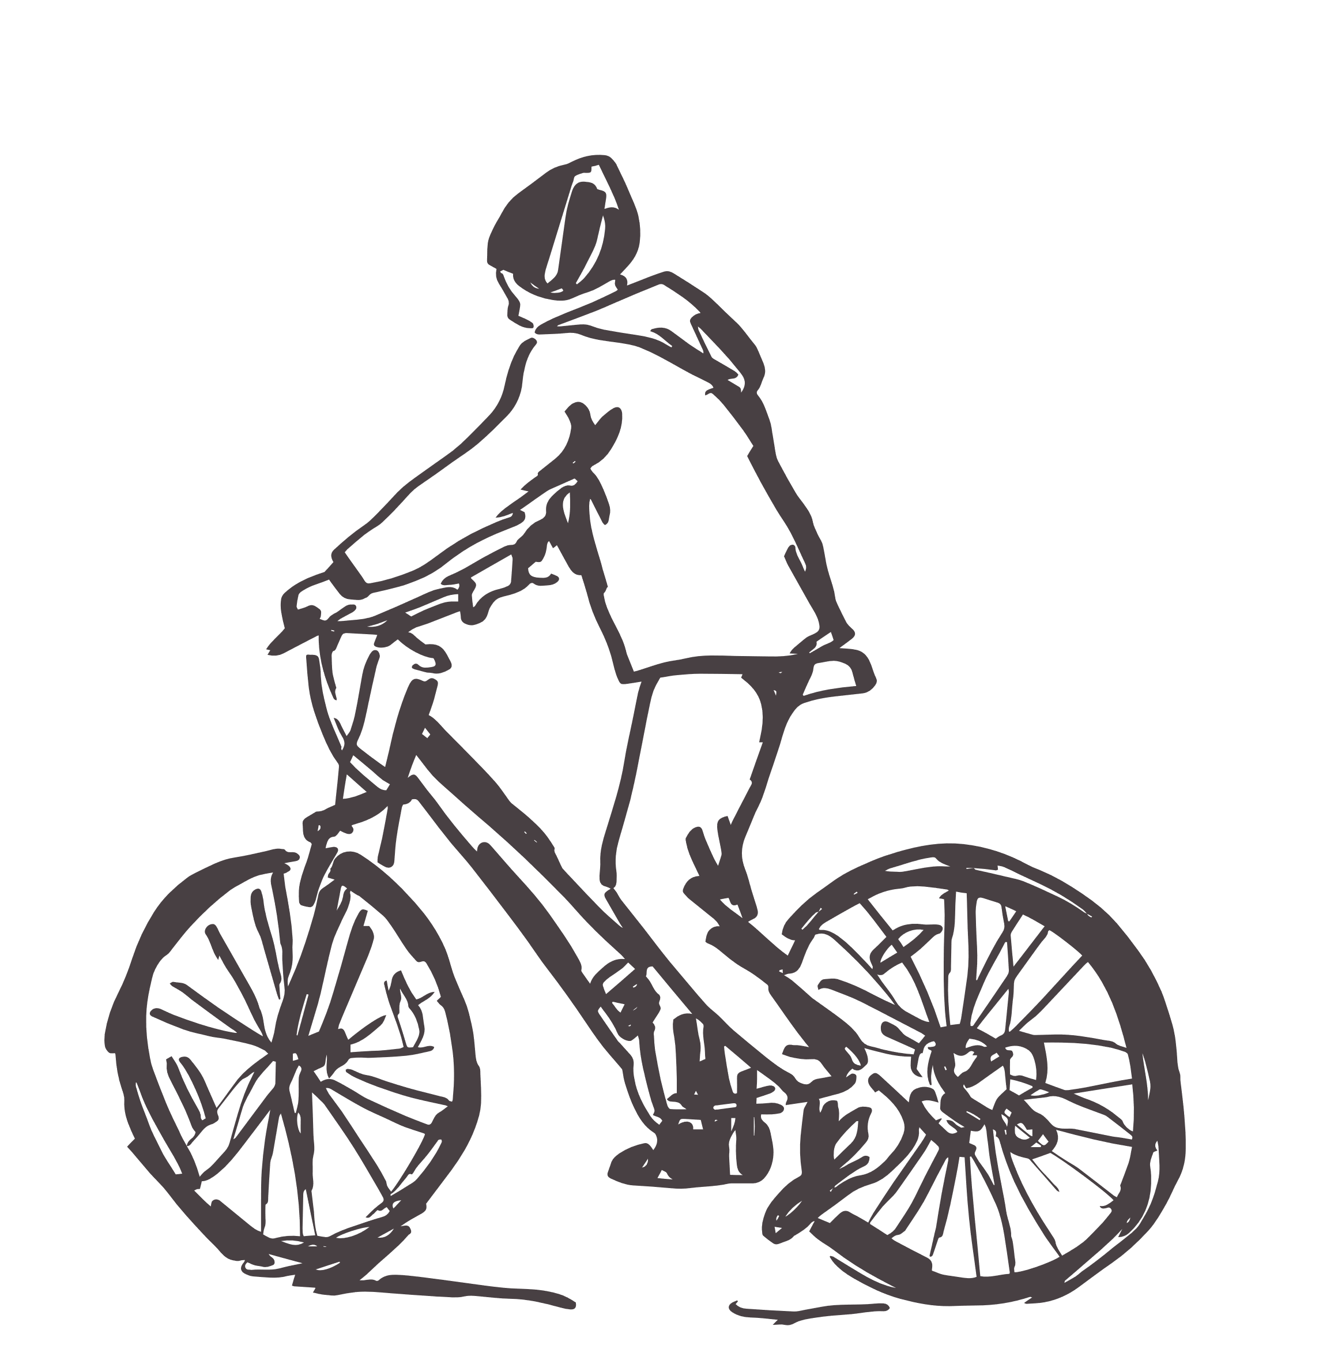
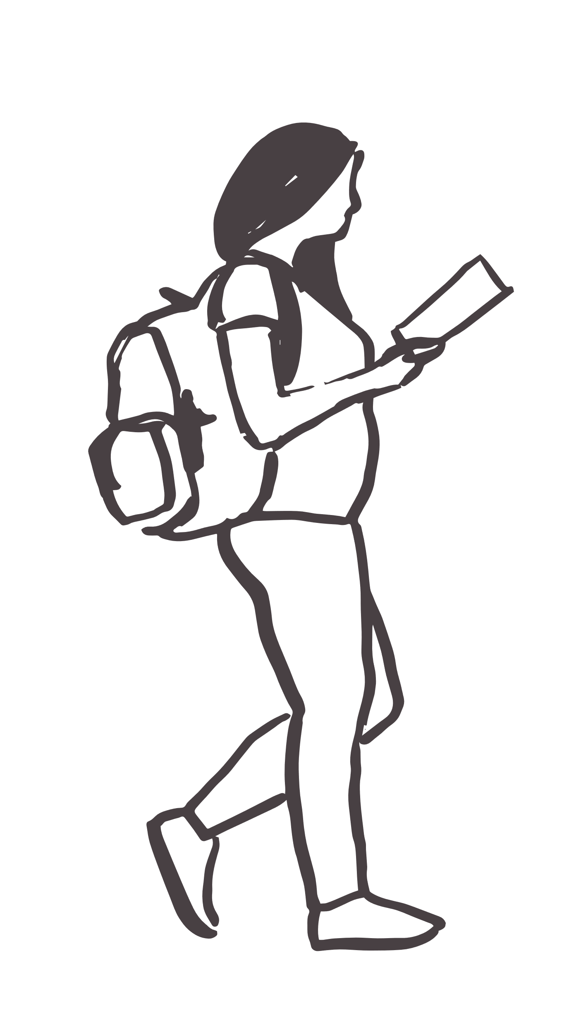
Children & Young People Physical Activity Behaviour
Active Lives
Children’s Survey
2022-23 Headlines

Slide 2
The Active Lives Survey: Children and Young People gathers data on how children engage with sport and physical activity
Designed by Sport England, the Department for Education (DfE), the Department for Health (DfH), and the Department for Digital Culture Media and Sport (DCMS), its purpose is to gain a detailed insight into the current physical activity habits of the nation's children and young people (aged 5 to 16).
The survey collects data to present a comprehensive picture of children and young people’s:
Overall levels of activity both during the school day (‘at school’) and outside school
Activity levels for a range of key demographic groups
Chosen activities by age group
Volunteering levels (supporting sport and physical activity)
Associations between activity levels and measures of mental wellbeing, individual development and social and community development
Attitudes towards sport and physical activity
For more information about the survey please visit Sport England's website
Notes:
The results presented are year 5 (21/22 academic year). Since the year 1 data was published, there’s been a change to the UK Chief Medical Officer’s physical activity guidelines for children and young people. Instead of at least 60 minutes of activity every day, the new guidelines recommend young people engage in moderate to vigorous intensity activity for an average of at least 60 minutes a day across the week. The data for all years is now presented to reflect this change in guidelines.

Slide 3
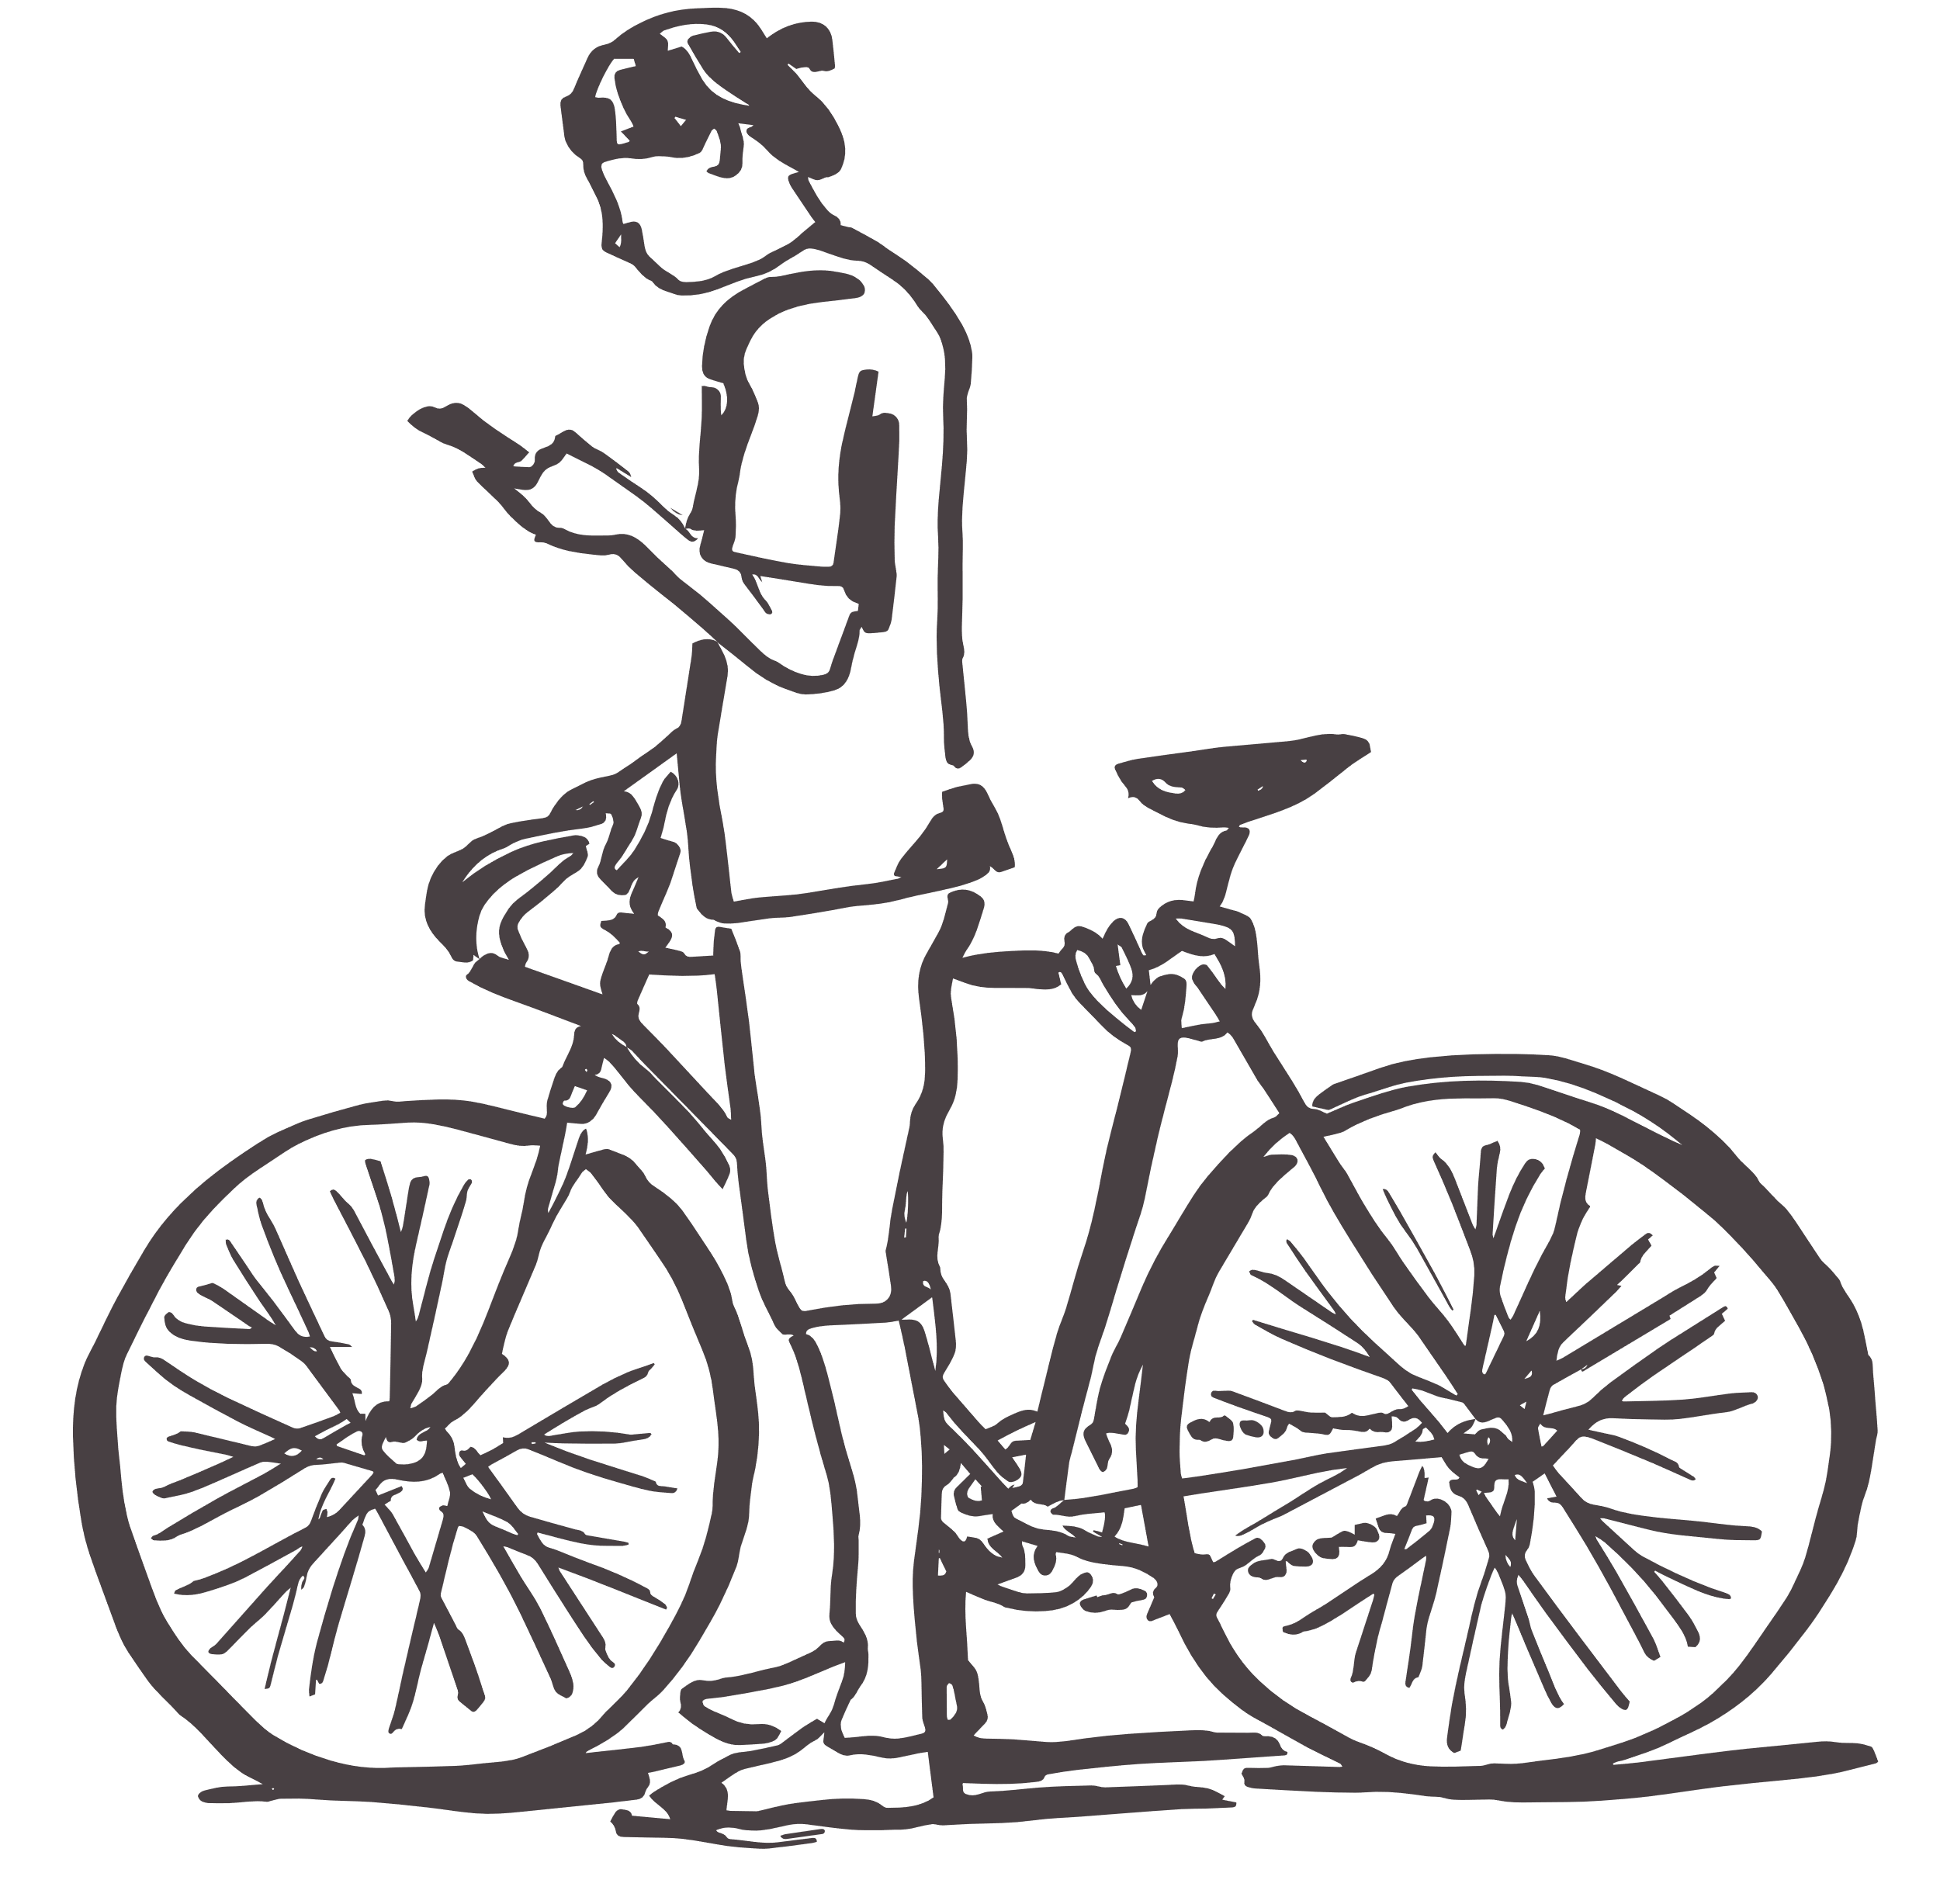
How much physical activity should children and young people do?
Activity levels for Children and young people are presented in three categories (for overall activity in the last week):
Active
(Chief Medical Officer guidelines)
An average of 60 minutes or more a day
(at least 420 mins over a week)
Fairly active
An average of 30-59 minutes a day
Less active
Less than an average of 30 minutes a day
Note: Only activity of at least moderate intensity is included
Notes:
Moderate intensity activity
Is defined as activity where you raise your heart rate and feel a little out of breath (children were asked whether it made them breathe faster)

Slide 4
National - headlines
The following headlines and demographic observations have been extracted from the full report
Children and young people’s overall activity levels are stable as the initial recovery from the pandemic was maintained across the 2022-23 academic year. It means 47% of children are meeting the Chief Medical Officers’ guidelines of taking part in an average of 60 minutes or more of sport and physical activity a day. The 22-23 findings reinforce that participation in sport and physical activity varies greatly. Significant inequalities remain in activity levels, with Black (40%) and Asian (40%) children and young people, and those from lower affluent families (44%), still less likely to play sport or be physically active than the average across all ethnicities and affluence groups. Girls are also less likely to be active than boys. The release also reveals a number of positive stories, however, including 1.5% more girls playing football since the Lionesses won Euro 2022. There are 11.5% more children and young people walking, cycling or scootering to get places than there were five years ago (academic year 2017-18) as increases to active travel during the pandemic have been maintained since society returned to normal.
Source: Sport England, Active Lives Children and Young People Survey – Academic year 2022-23 Report

Slide 5
National - demographics
Activity levels among infant age children (school Years 1-2, ages 5-6) have been fairly stable over time, barring a drop during the height of the coronavirus pandemic restrictions in 2019-20. There’s no reportable long-term change.
The proportion of children and young people classified as active has remained fairly stable over the longer term among young people in school Years 7-8 (ages 11-13).
Activity levels have been stable over the last 12 months for boys and girls with growth over the longer term at a similar rate for both. As a result, the gender gap between boys and girls currently stands at 6.8%, the same as the gap recorded in 2017-18. There are two notable gender differences when considering specific age groups:
Infant age (school Years 1-2, ages 5-7) girls have seen no long-term growth in activity levels, whereas boys have seen an increase of 3.5% compared to academic year 2017- 18. As a result the gender gap for this age group has widened to 9.2% (from 6.3% in 2017-18)
Teenage girls (school Years 9-11, ages 13-16) are seeing slightly stronger growth in activity levels over the longer term compared to teenage boys (10.9% vs 8.7%). Despite this, the gender gap for this age group remains wide at 7.3%
Source: Sport England, Active Lives Children and Young People Survey – Academic year 2022-23 Report

Slide 6
National – demographics continued
The proportion of active children and young people, both with and without a disability or long-term health condition, has remained unchanged compared to 12 months ago. Both groups have seen growth over the last three years, but this has been slightly greater for those with a disability or long-term health condition (up 4.5% vs 2.3% for those without).
The gap between activity levels among Asian and Black children and young people, and those of all other backgrounds, has widened over the last five years (since academic year 2017-18). Children and young people of White other ethnicity are now the most active group, having seen the largest increases, while those of Mixed ethnicities remain equally as likely to be active as those who are White British. The gender gap remains widest between Asian girls and boys (11%), followed by Black (9%) and Other (9%) children and young people.
Children and young people from the least affluent families are the least likely to be active, with only 44% meeting the Chief Medical Officers’ guidelines - compared to 55% of those from the most affluent families. However, while all groups have seen growth over the last five years (compared to academic year 2017-18), this has been slightly greater among those from the least affluent families (up 5.5% vs 3.5% for most affluent), so the gap in activity levels between those from the most and least affluent families has narrowed slightly.
Source: Sport England, Active Lives Children and Young People Survey – Academic year 2022-23 Report

Slide 7
Activity levels of whole population trends
Notes:
The Chief Medical Officer’s (CMO) guidelines for young people is presented in three categories for overall activity in the last week:
Active
An average of 60 minutes or more a day
Less active
Less than an average of 30 minutes a day
Note: Only activity of at least moderate intensity is included

Slide 8
Responses per year
 | 17-18 | 18-19 | 19-20 | 20-21 | 21-22 | 22-23
England | 109,503 | 113,728 | 89,303 | 86,828 | 104,404 | 122,347
Active Humber | 2,658 | 1,707 | 1,470 | 1,288 | 2,329 | 3,085
Hull | 646 | 255 | ^ | ^ | ^ | 983
East Riding of Yorkshire | 605 | 336 | 292 | ^ | 450 | 195
North East Lincolnshire | 863 | 619 | 581 | ^ | 261 | 496
North Lincolnshire | 544 | 497 | 500 | 1,117 | 1110 | 1,411
Notes:
‘^’ is used when there are less than 3 schools returning responses or there are less than 150 pupils

Slide 9
Physical activity levels: Academic Year 2022-23
Notes:
The Chief Medical Officer’s (CMO) guidelines for young people is presented in three categories for overall activity in the last week:
Active
An average of 60 minutes or more a day
Fairly active
An average of 30-59 minutes a day
Less active
Less than an average of 30 minutes a day
Note: Only activity of at least moderate intensity is included

Slide 10
Local authority physical activity levels
 | Active
 | 17-18 | 18-19 | 19-20 | 20-21 | 21-22 | 22-23
England | 43.3% | 46.8% | 44.9% | 44.6% | 47.2% | 47.0%
Active Humber | 42.1% | 48.4% | 46.1% | 45.1% | 48.7% | 48.1%
Hull | 49.6% | 60.2% | 0.0% | 0.0% | 0.0% | 45.3%
East Riding of Yorkshire | 38.3% | 60.3% | 48.3% | 0.0% | 49.3% | 52.2%
North East Lincolnshire | 39.0% | 46.5% | 49.5% | 0.0% | 55.4% | 51.4%
North Lincolnshire | 40.2% | 38.0% | 41.6% | 41.2% | 47.4% | 47.9%
 | Less Active
 | 17-18 | 18-19 | 19-20 | 20-21 | 21-22 | 22-23
England | 32.9% | 29.0% | 31.3% | 32.4% | 30.1% | 30.2%
Active Humber | 33.3% | 25.5% | 31.5% | 31.3% | 32.9% | 29.7%
Hull | 30.2% | 20.0% | 0.0% | 0.0% | 0.0% | 31.0%
East Riding of Yorkshire | 29.0% | 16.8% | 30.5% | 0.0% | 33.2% | 24.3%
North East Lincolnshire | 37.3% | 26.8% | 25.9% | 0.0% | 24.0% | 29.6%
North Lincolnshire | 36.8% | 31.5% | 37.3% | 35.4% | 35.3% | 30.0%
Data is for: The Humber
Notes:
‘^’ is used when there are less than 3 schools returning responses or there are less than 150 pupils

Slide 11
Change in physical activity levels
Between 17-18 and 22-23 (baseline)
 | Active |  |  | Less Active
England | 3.8% | Significant improvement |  | -2.7% | Significant improvement
Active Humber | 6.0% | Significant improvement |  | -3.6% | No change
Hull | -4.3% | No change |  | 0.9% | No change
East Riding of Yorkshire | 14.0% | Significant improvement |  | -4.8% | No change
North East Lincolnshire | 12.5% | Significant improvement |  | -7.7% | Significant improvement
North Lincolnshire | 7.7% | No change |  | -6.8% | No change
And in the last 12 months (21-22 to 22-23)
England | -0.2% | No change |  | 0.1% | No change
Active Humber | -0.6% | No change |  | -3.3% | No change
Hull | -2.4% | No change |  | -0.3% | No change
East Riding of Yorkshire | 2.9% | No change |  | -9.0% | Significant improvement
North East Lincolnshire | -4.0% | No change |  | 5.5% | No change
North Lincolnshire | 0.5% | No change |  | -5.3% | Significant improvement
Data is for: The Humber
Notes:
‘^’ is used when there are less than 3 schools returning responses or there are less than 150 pupils

Slide 12
In summary, over half of children and young people still do not meet the CMO guidelines and almost a third are classed as less active
Active
The latest 2022-23 data shows 48.1% of children and young people in Active Humber are classed as active. The active rate is now lower (worse) than the last 12 months.
The active rate for Active Humber is now 1.1pp better than England (47.0%)
Less active
The latest 2022-23 data shows 29.7% of children and young people in Active Humber are classed as less active. This rate is lower (better) than the last 12 months.
Active Humber figures are now 0.5pp better than national (30.2%)
Data is for: The Humber
Source: Active Lives Children and Young People Survey 2022-23, headlines

Slide 13
National findings

Slide 14
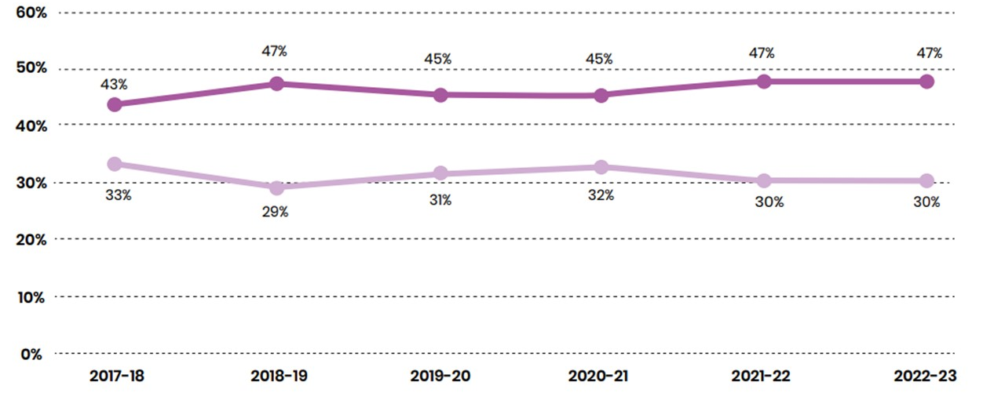
Overall, activity levels have remained stable over the last 12 months

Slide 15
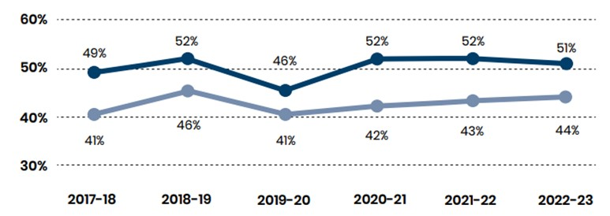
Activity levels have increased by less among primary age children
There’s an upward trend in activity levels among teenagers

Slide 16
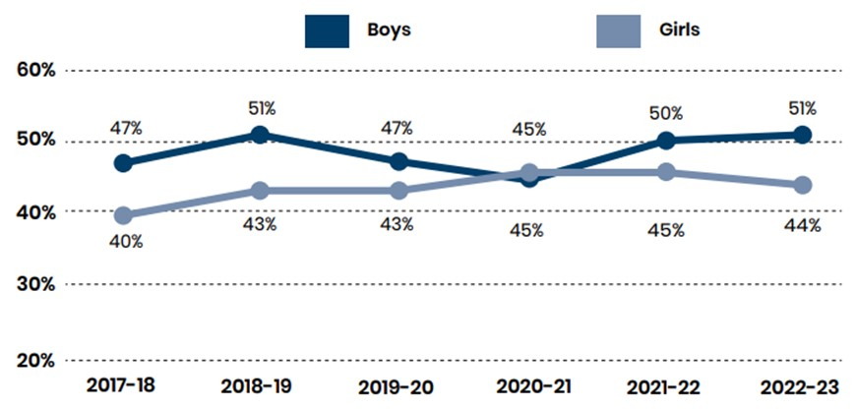
Both boys and girls have seen activity levels increase over the last five years

Slide 17
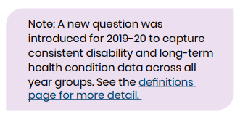
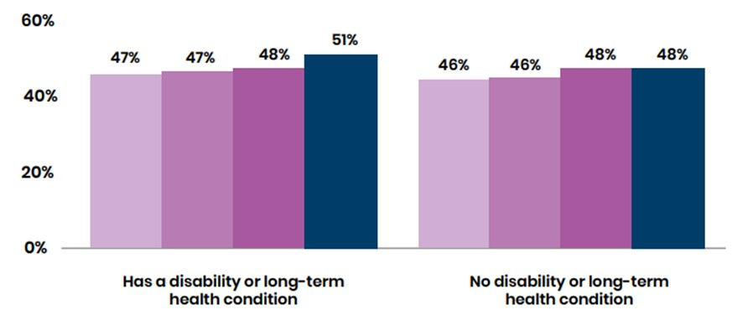
Activity levels have increased by more for children and young people with a disability or long- term health condition than for those without

Slide 18
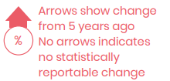
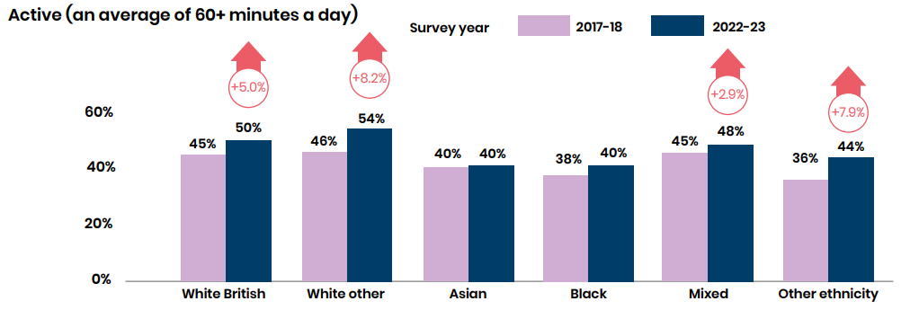
Asian and Black children and young people have seen no long-term growth in activity levels

Slide 19
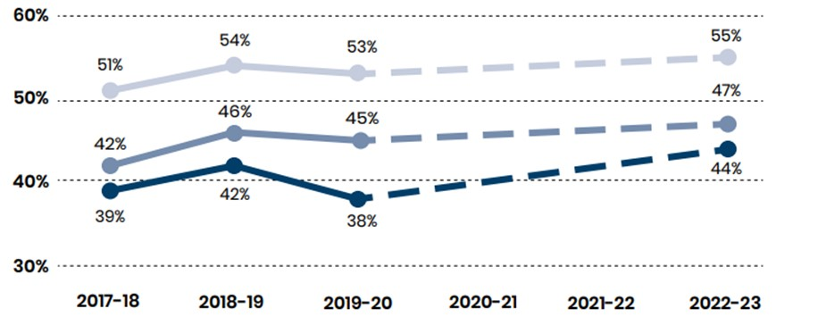
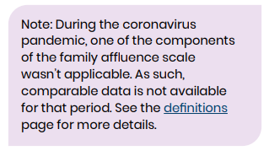
All affluence groups have seen activity levels increase over the longer term

