Slide 1
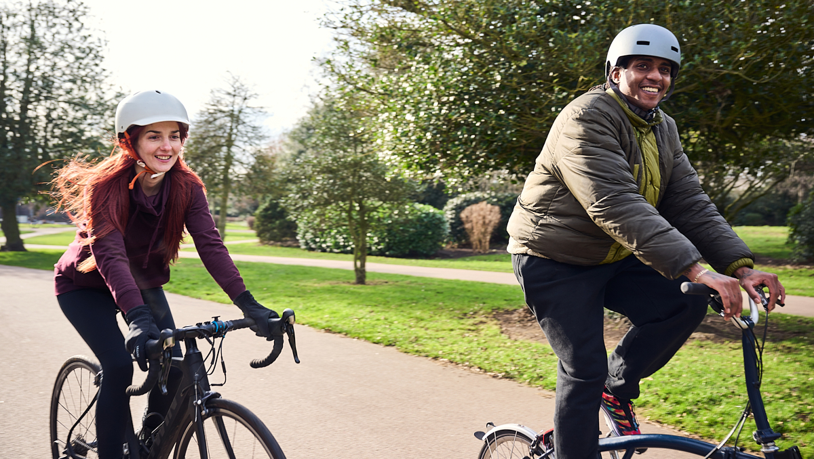

Adult Active Lives Headlines
November 2023-24
April 2025

Slide 2

National update
The number of people playing sport and taking part in physical activity in England is at the highest level on record, according to the latest Active Lives Adult Survey Report
The new figures show that, between November 2023 and November 2024, 63.7% of the adult population met the Chief Medical Officers’ guidelines of doing 150 minutes, or more, of moderate intensity physical activity a week.
That’s equivalent to 30 million adults in England playing sport or taking part in physical activity every week – up more than 2.4m from when the survey results were first published in 2016.
The number of inactive adults, those doing less than 30 minutes of activity a week, is down, with this number falling by 121,000 in the last 12 months.
This reflects significant progress, especially considering the huge disruption caused by the Covid-19 pandemic.
Source: Sport England, Active Lives Adult Survey November 2023-24 Report

Slide 3

National demographics
Over the longer term, growth has been similar for both men and women, with 1.8% more active men and 1.5% more active women compared to baseline. Despite this, neither men nor women have seen a statistically reportable change in activity levels compared to 12 months ago, although women have seen a small drop in those who are inactive over the same period.
Adults aged 55-74 and 75+ continue to see a slight but steady increase in activity levels over the last 3 years. The latest result represents an increase of 1.1% of adults aged 55-74 who are active, compared to 12 months ago. This is part of a long-term increase of 6.4% compared to baseline. While adults aged 75+ have seen no statistically reportable change in the proportion active compared to 12 months ago, there has been a long-term increase of 9.4% compared to baseline.
While the proportion active remains unchanged compared to 12 months ago for those with a disability or long-term health condition, the proportion who are inactive has fallen slightly. Before the pandemic, activity levels were increasing and, as such, there are 4.8% more active adults with a disability or long-term health condition compared to baseline. This long-term growth is greater than for those without a disability, where the proportion active is up by 2.2% over the same period.
There has been no statistically reportable change in the proportion who are active for any Black, Asian or minority ethnic group compared to baseline.
This is also true for social grade compared to 12 months ago. However, there has been long-term growth in activity levels among the most affluent (NS-SEC 1-2), with those who are active increasing by 1.6% compared to baseline. In contrast, among the least affluent (NS-SEC 6-8) the proportion active dropped by 2.5% over the same period. There is an increased gap between the two.
Source: Sport England, Active Lives Adult Survey November 2023-24 Report

Slide 4
Physical inactivity in the Humber is at an all time low
Active (England)
Active (Humber)
Inactive (Humber)
Inactive (England)
Source: Sport England, Active Lives Adults, Nov 2015-16 and Nov 23-24, excluding gardening

Slide 5
Inactivity compared to 2015-16 (baseline)
Source: Sport England, Active Lives Adults, Nov 2015-16 and Nov 23-24, excluding gardening

Slide 6
Absolute change
Nov 2015-16 to Nov 2023-24
 | Inactive |  | Fairly Active |  | Active
England | -0.4% | Significant decrease | -1.2% | Significant decrease | 1.6% | Significant increase
Active Humber | -0.3% | No change | -0.2% | No change | 0.5% | No change
Kingston upon Hull, City of | 1.4% | No change | -3.2% | No change | 1.8% | No change
East Riding of Yorkshire | -0.4% | No change | 2.0% | No change | -1.6% | No change
North Lincolnshire | -2.1% | No change | 3.5% | No change | -1.4% | No change
North East Lincolnshire | -0.8% | No change | -3.8% | No change | 4.6% | No change
Source: Sport England, Active Lives Adults, Nov 2015-16 and Nov 2023-24, excluding gardening

Slide 7
Inactivity compared to 2022-23 (previous 12 months)
Source: Sport England, Active Lives Adults, Nov 2022-23 and Nov 23-24, excluding gardening

Slide 8
Change in last 12 months
Nov 2022-23 to Nov 2023-24
 | Inactive |  | Fairly Active |  | Active
England | -0.5% | Significant decrease | 0.3% | No change | 0.3% | No change
Active Humber | -2.3% | No change | -0.5% | No change | 2.8% | No change
Kingston upon Hull, City of | -3.2% | No change | -1.3% | No change | 4.5% | No change
East Riding of Yorkshire | -1.4% | No change | -0.0% | No change | 1.4% | No change
North Lincolnshire | -4.2% | No change | 2.8% | No change | 1.4% | No change
North East Lincolnshire | -0.7% | No change | -3.7% | No change | 4.4% | No change
Source: Sport England, Active Lives Adults, Nov 2021-22 and Nov 2023-24, excluding gardening

Slide 9

Summary
Over the last 12 months, inactivity rates have decreased by 2.3pp to 28.6%. Nationally, this has reduced by 0.5pp to 25.1%
Humber ranks 39th out of 44 Active Partnerships
Inactivity is similar to baseline (15-16 28.9%) and pre pandemic lows (18-19 28.7%)
Kingston upon Hull is the only LA to see an increase in inactivity levels since baseline (up 1pp)
Source: Sport England, Active Lives Adults, Nov 2015-16 and Nov 2023-24, excluding gardening

Slide 10

Appendix
Physical activity over the years

Slide 11
Activity levels November 2015-16
Source: Sport England, Active Lives Adults, Nov 2015-16, excluding gardening

Slide 12
Activity levels November 2016-17
Source: Sport England, Active Lives Adults, Nov 2016-17, excluding gardening

Slide 13
Activity levels November 2017-18
Source: Sport England, Active Lives Adults, Nov 2017-18, excluding gardening

Slide 14
Activity levels November 2018-19
Source: Sport England, Active Lives Adults, Nov 2018-19, excluding gardening

Slide 15
Activity levels November 2019-20
Source: Sport England, Active Lives Adults, Nov 2019-20, excluding gardening

Slide 16
Activity levels November 2020-21
Source: Sport England, Active Lives Adults, Nov 2020-21, excluding gardening

Slide 17
Activity levels November 2021-22
Source: Sport England, Active Lives Adults, Nov 2021-22, excluding gardening

Slide 18
Activity levels November 2022-23
Source: Sport England, Active Lives Adults, Nov 2022-23, excluding gardening

Slide 19
Activity levels November 2023-24
Source: Sport England, Active Lives Adults, Nov 2023-24, excluding gardening

