Slide 1
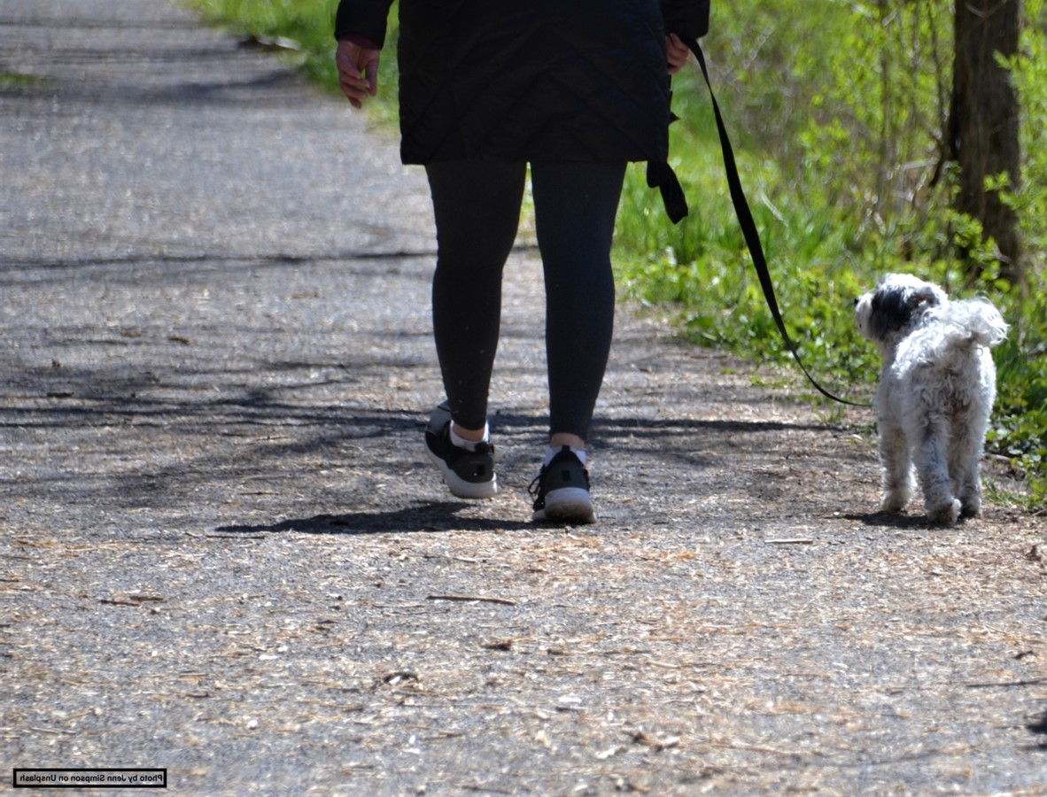

Adult Active Lives
November 2022-23
Headlines
April 2024

Slide 2
National update
There are two million more adults getting active on a regular basis through sport and physical activity than in 2016, despite the impacts of the coronavirus (Covid-19) pandemic and increased cost-of-living pressures.
The figures, which we’ve published today in our latest Active Lives Adult Survey report, show that between November 2022 and November 2023, 63.4% of the adult population met the Chief Medical Officers’ guidelines of doing 150 minutes, or more, of moderate intensity physical activity a week. That’s equivalent to 29.5m adults in England playing sport or taking part in physical activity every week.
This figure is largely unchanged from 12 months ago when 63.1% were active but means that, compared to when we first ran the survey between November 2015 and November 2016, there are two million more active adults – an increase of 1.3%.

Slide 3
National demographics
Over the longer term, growth has been similar for both men and women, with 914,000 (1.4%) more active men and 831,000 (1.3%) more active women compared to November 2015-16. Despite this, neither men nor women have seen activity levels change compared to 12 months ago
Adults aged 75+ continue to drive the growth in activity levels. The increase of just over 100,000 (1.6%) adults aged 75+ who are active, compared to 12 months ago, is part of a long-term increase of just under 700,000 (9.4%) compared to seven years ago (Nov 15-16). Those aged 55-74 also have a long-term upward trend in the proportion active. For both age groups the latest result represents the highest result recorded over the last seven years.
Activity levels remain unchanged compared to 12 months ago for those with a disability or long-term health condition. Before the pandemic, activity levels were increasing and we continue to see 4.2% more active adults with a disability or long-term health condition compared to seven years ago (Nov 15-16). This long-term growth is greater than for those without a disability or long-term health condition, where the proportion active is up by 1.9% over the same period.
No Black, Asian or minority ethnic group is showing a reportable difference in the proportion who are active compared to November 2015-16. As a result, inequalities continue to widen as White British adults have seen activity levels increase over the same period (up 2.1%).
There have been no reportable changes in activity levels by social grade compared to 12 months ago. Given this stability, we expect no further pandemic recovery for the least affluent (NS SEC 6-8) and the longerterm trend of an increased gap in activity levels between the most and least affluent to continue. The most affluent (NS-SEC 1-2) have seen long-term growth, with those who are active increasing by 1.6% compared to seven years ago (Nov 15-16). In contrast, the least affluent (NS-SEC 6-8) have seen the proportion active drop by 2.2% over the same period.

Slide 4
Physical activity levels
Source: Sport England, Active Lives Adults, Nov 2015-16 to Nov20 22-23, excluding gardening

Slide 5
Inactivity compared to 2015-16 (baseline)
Source: Sport England, Active Lives Adults, Nov 2015-16 and Nov 22-23, excluding gardening

Slide 6
Absolute change
Nov 2015-16 to Nov 2022-23
 | Inactive |  | Fairly Active |  | Active
England | 0.1% | No change | -1.4% | Significant decrease | 1.3% | Significant increase
Active Humber | 2.0% | No change | 0.2% | No change | -2.2% | No change
Kingston upon Hull, City of | 4.7% | No change | -1.9% | No change | -2.7% | No change
East Riding of Yorkshire | 1.0% | No change | 2.0% | No change | -3.0% | No change
North Lincolnshire | 2.1% | No change | 0.6% | No change | -2.7% | No change
North East Lincolnshire | -0.1% | No change | -0.2% | No change | 0.3% | No change
Source: Sport England, Active Lives Adults, Nov 2015-16 and Nov 2022-23, excluding gardening

Slide 7
Inactivity compared to 2021-22 (previous 12 months)
Source: Sport England, Active Lives Adults, Nov 2021-22 and Nov 2022-23, excluding gardening

Slide 8
Change in the last 12 months
Nov 2021-22 to Nov 2022-23
 | Inactive |  | Fairly Active |  | Active
England | -0.1% | No change | -0.2% | No change | 0.3% | No change
Active Humber | 0.7% | No change | 0.2% | No change | -0.9% | No change
Kingston upon Hull, City of | -0.1% | No change | -0.1% | No change | 0.2% | No change
East Riding of Yorkshire | 3.5% | No change | 0.0% | No change | -3.5% | No change
North Lincolnshire | -2.4% | No change | -3.1% | No change | 5.5% | No change
North East Lincolnshire | -1.0% | No change | 4.5% | No change | -3.5% | No change
Source: Sport England, Active Lives Adults, Nov 2021-22 and Nov 2022-23, excluding gardening

Slide 9
Summary
Since baseline:
Inactivity rates have increased by 2pp in The Humber. Nationally, inactivity rates have decreased by 0.1pp
Inactivity rates have either increased or are similar to baseline for all LAs in The Humber
Hull has seen the biggest increase since baseline (4pp)
In the last 12 months:
Inactivity rates have increased by 0.7pp in The Humber. Nationally, inactivity rates have decreased by 0.1pp
Hull has the highest inactivity rates within The Humber (33%)
East Riding has seen the biggest increase in inactivity (3pp) but remain the lowest
North Lincolnshire and North East Lincolnshire have both seen some improvements in the last 12 months (2.4 and 0.9pp respectively)

