Slide 1
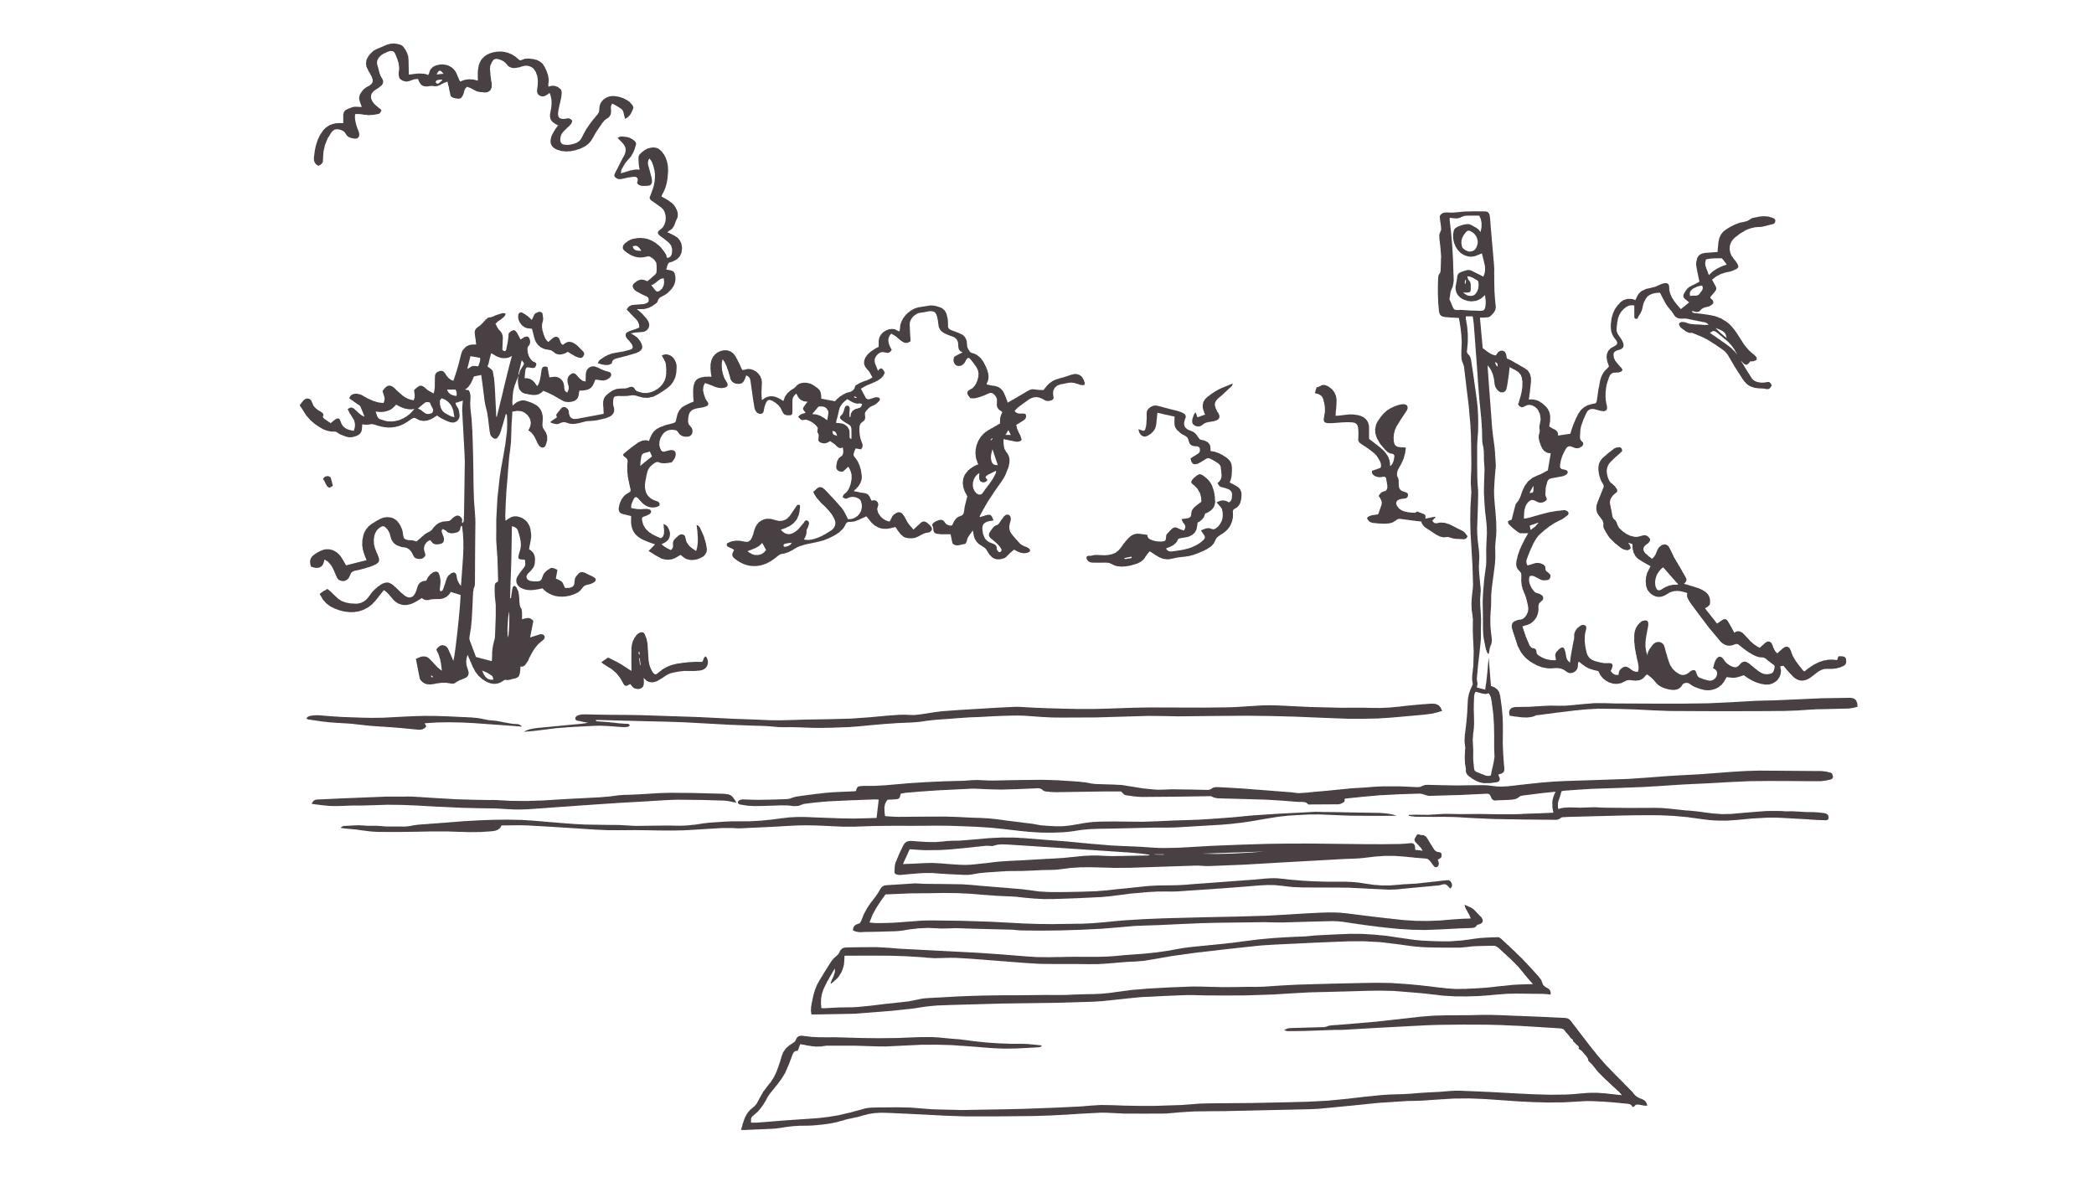
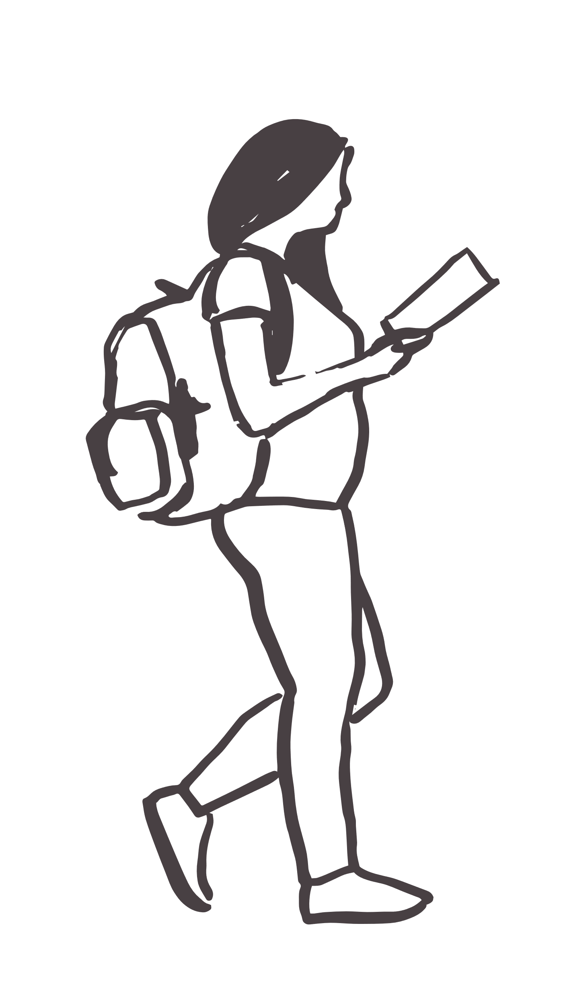
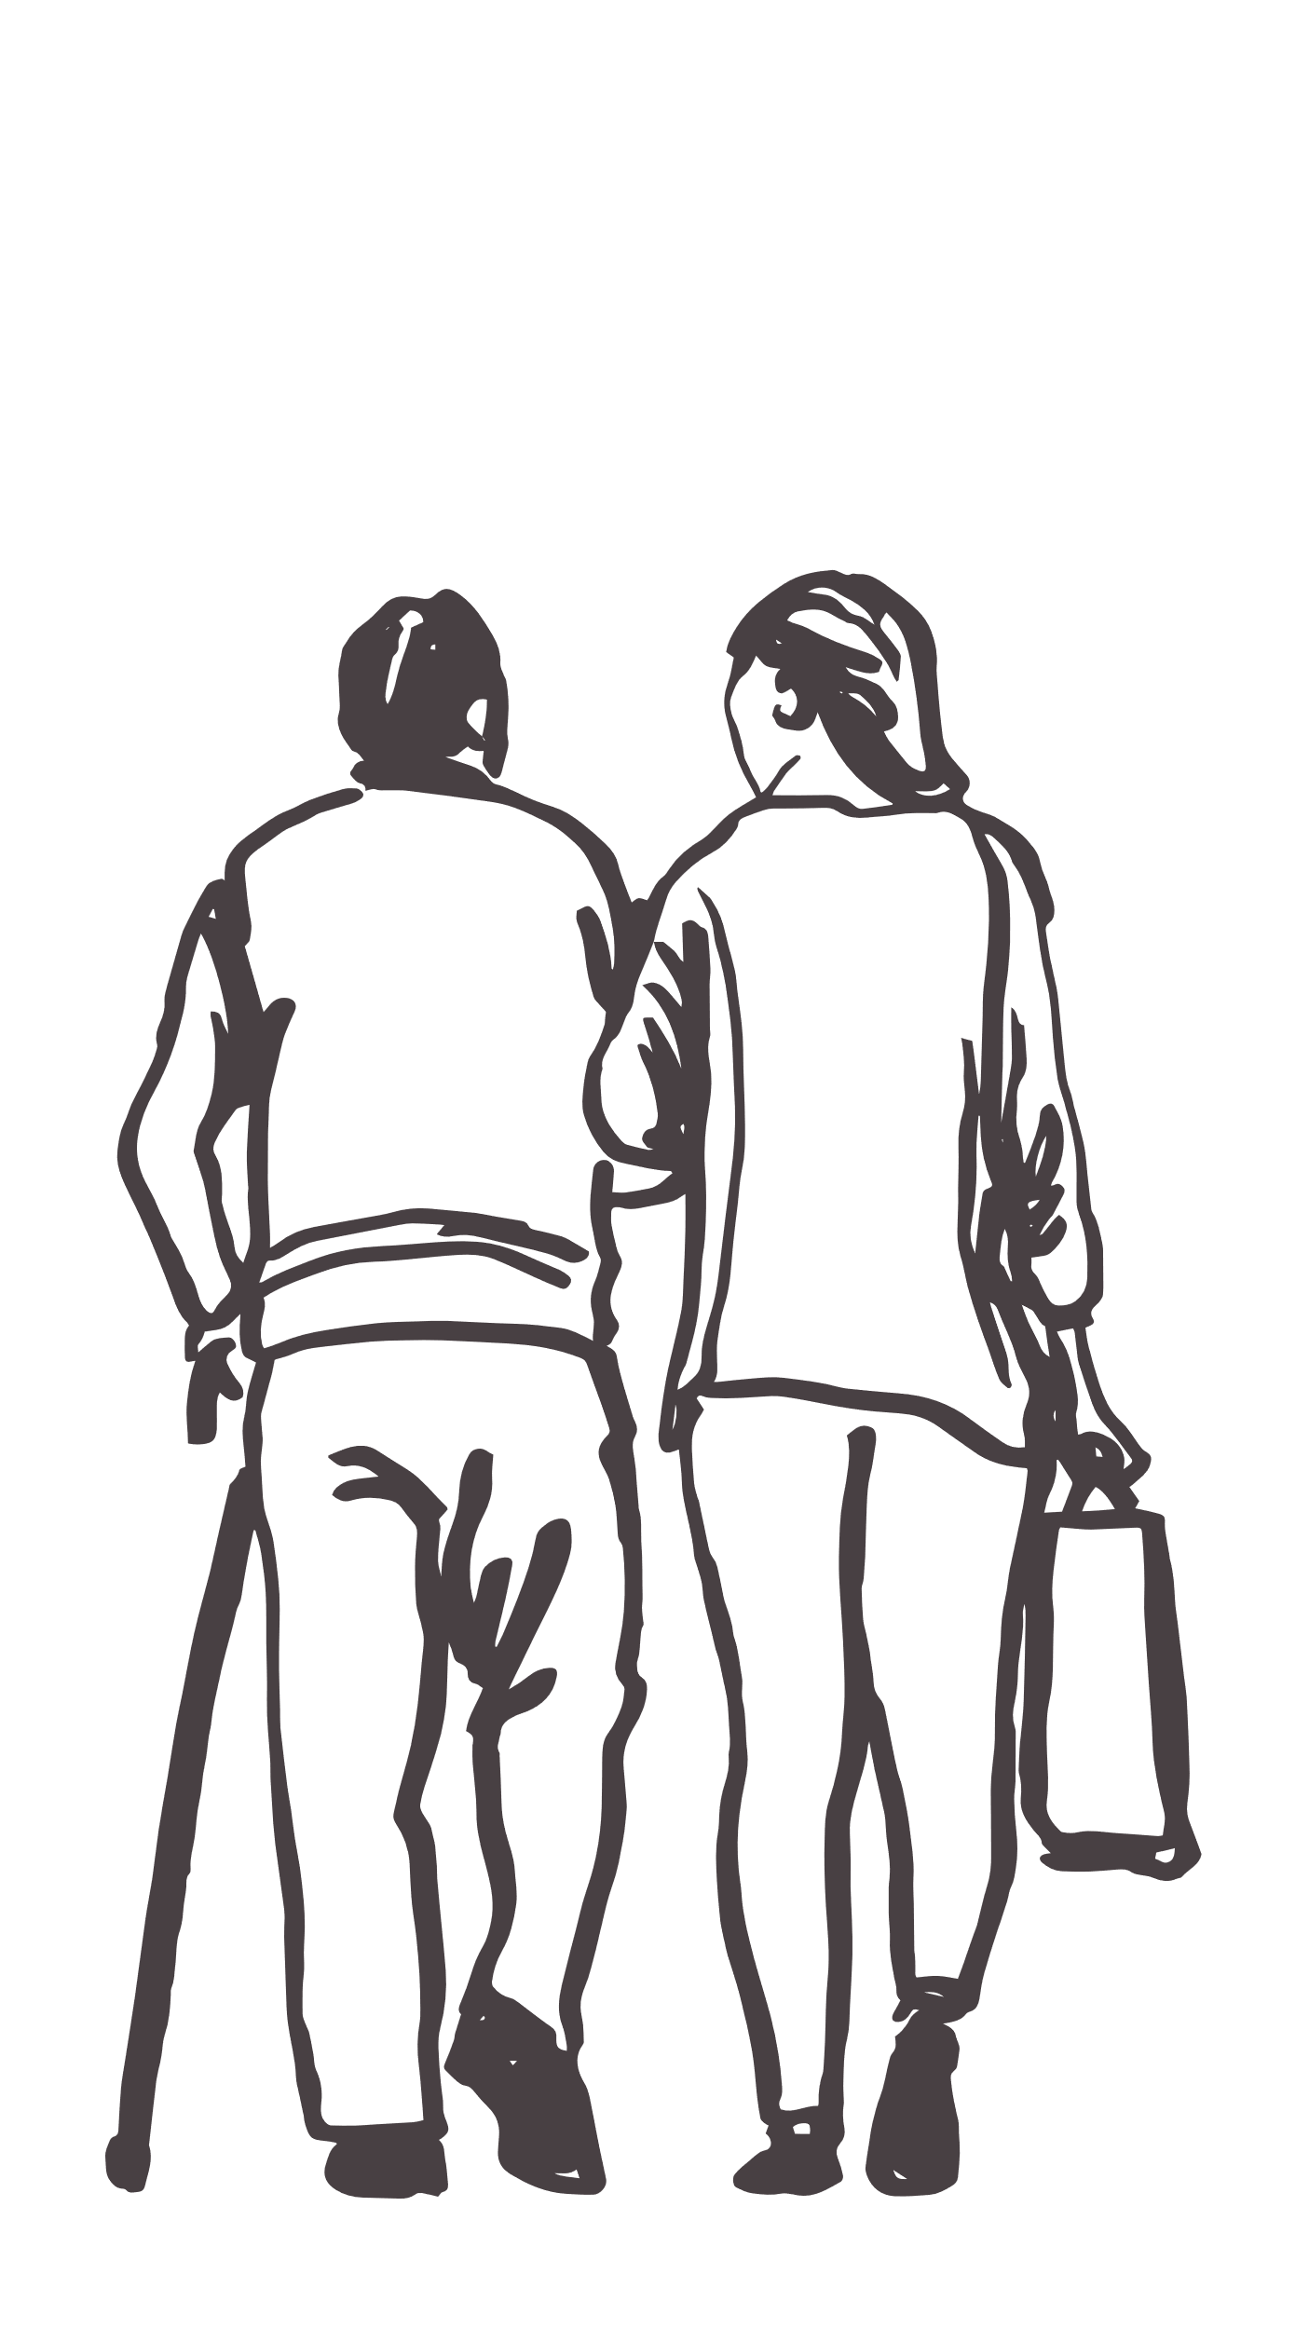
An insight into walking
Active Lives survey 20-21

Slide 2
Active levels have improved in the latest year
Data is for: North East Lincs
Source: Sport England, Active Lives Adult, Nov 2015-16 to 2020-21, age 16+, excluding gardening Measure: percentage of adults (16+) doing less than 30 minutes of physical activity per week
Notes:
Sample Size
15-16 16-17 17-18 18-19 19-20 20-21
505 502 512 502 487 498

Slide 3
Alternative ways of measuring walking
Any walking
In the last 12 months
Two sessions of moderate activity for at least 10 minutes in the last 28 days
Zero sessions of moderate activity for at least 10 minutes in the last 28 days
Data is for: North East Lincs
Source: Sport England, Active Lives Adult, Nov 2015-16 to 2020-21, age 16+
Notes:
There are other measures which don’t rely on the 10minute bouts, these must also be for over 60 minutes in total
TfE use twice a week measure
Sample
North East Lincolnshire 498

Slide 4
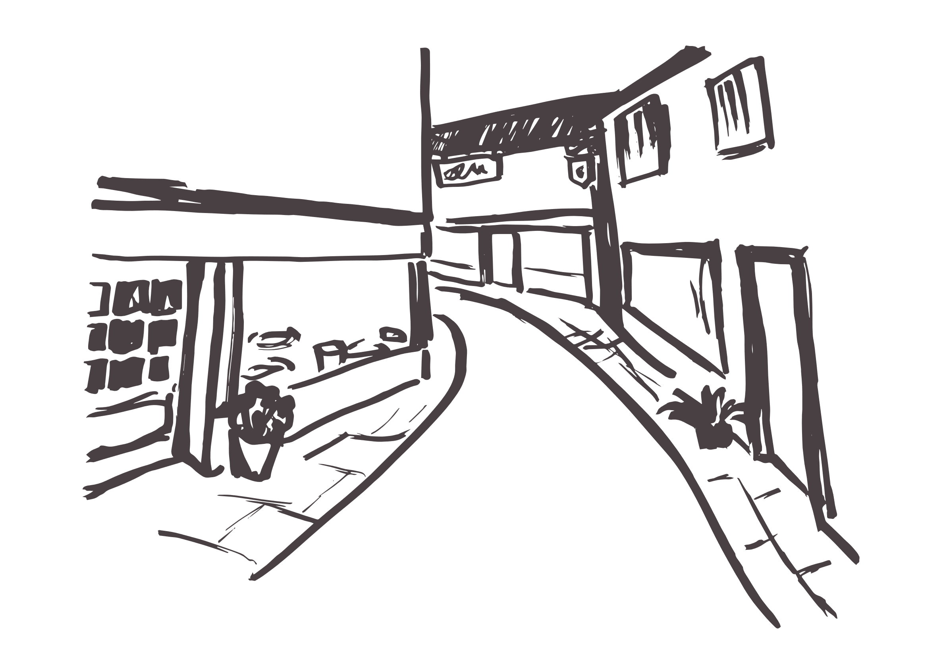
How we measure walking
Walking regularly 7 or more sessions per week (28 sessions per month)
Walking fairly regularly Between 2 and 6 sessions per week (8-27 sessions)
Walking less regularly Less than 2 sessions per week (1-7 sessions per month)
Not walking 0 sessions of 10+ minutes per month
Data is for: North East Lincs
Source: Sport England, Active Lives Adult, Nov 2015-16 to 2020-21, age 16+ Measure: Number of sessions walking per week
Notes:
Sessions are all 10+ minutes

Slide 5
Those that don’t walk are much more likely to be inactive
Data is for: North East Lincs
Source: Sport England, Active Lives Adult, Nov 2015-16 to 2020-21, age 16+, excluding gardening Measure: percentage of adults (16+) doing less than 30 minutes of physical activity per week

Slide 6
Pre-Covid
The proportion of those not walking remains high
Data is for: North East Lincs
Source: Sport England, Active Lives Adult, Nov 2015-16 to 2020-21, age 16+ Measure: Number of sessions walking per week
Notes:
Sample size
15-16 505
16-17 508
17-18 512
18-19 502
19-20 487
20-21 498

Slide 7
Adults with a limiting illness or aged 16-34 are least likely to walk
Least likely to walk
Most likely to walk
Data is for: North East Lincs
Source: Sport England, Active Lives Adult, 2020-21, age 16+
Measure: Not walking – 0 sessions per week
Notes:
Sample
Limiting illness 108
16-34 73
Male 212
NS SEC 6-8 103
35-54 156
White British 475
Female 285
NS SEC 3-5 131
55-74 212
75+ 55
NS SEC 1-2 174
No limiting illness 352
Minority ethnic group 10

Slide 8
By ethnic group, our White Other communities are least likely to walk
Least likely to walk
Most likely to walk
Data is for: North East Lincs
Source: Sport England, Active Lives Adult, Nov 2015-16 to 2020-21 combined, age 16+ Measure: Not walking – 0 sessions per week
Notes:
Sample size
White Other 65
White British 2825
Asian 35
Mixed 10
Other ethnic group 4
Black 8

Slide 9
Walking rates are worse within young adults (16-34)
Not walking – 0 sessions per week
Data is for: North East Lincs
Source: Sport England, Active Lives Adult, 2020-21, age 16+
Measure: Not walking – 0 sessions per week
Notes:
Lower is better
Average sample size
Whole population 502
Male 224
Female 277
Limiting illness 106
No limiting illness 363
16-34 85
35-54 146
55-74 205
75+ 61
NS SEC 1-2 179
NS SEC 3-5 136
NS SEC 6-8 93
White British 471
Minority ethnic group 20

Slide 10
Unemployed adults and students are less likely to walk
Data is for: North East Lincs
Source: Sport England, Active Lives Adult, Nov 2015-16 to 2020-21 combined, age 16+ Measure: Not walking – 0 sessions per week
Notes:
Sample size:
Unemployed 114
Student 71
Working full or part time 1423
Not working 1206

Slide 11
Adults in more deprived areas are less likely to walk
Not walking
Least deprived
Most deprived
Data is for: North East Lincs
Source: Sport England, Active Lives Adult, Nov 2015-16 to 2020-21 combined, age 16+ Measure: Not walking – 0 sessions per week
Notes:
Sample size
Least deprived quartile 639
Second least deprived quartile 703
Second most deprived quartile 541
Most deprived quartile 1129

Slide 12
Constrained city dwellers are least likely to walk
Least likely to walk
Most likely to walk
Data is for: North East Lincs
Source: Sport England, Active Lives Adult, Nov 2015-16 to 2020-21 combined, age 16+ Measure: Not walking – 0 sessions per week
Notes:
Sample size
Constrained City Dwellers 261
Hard-Pressed Living 548
Rural Residents 122
Urbanites 186
Suburbanites 877
Multicultural Metropolitans 5
Cosmopolitans 0

Slide 13
Pre-Covid
All walking includes walking for travel and walking for leisure
The total time adults spent walking* was fairly stable during the pandemic but is now increasing
Minutes spent walking
*All walking
Data is for: North East Lincs
Source: Sport England, Active Lives Adult, Nov 2015-16 to 2020-21, age 16+ Measure: Average number of minutes walking per week
Notes:
All walking (minutes)
15-16 16-17 17-18 18-19 19-20 20-21
240 221 267 275 263 293
Sample
15-16 16-17 17-18 18-19 19-20 20-21
572 561 512 502 487 497

Slide 14
Pre-Covid
The pandemic negatively affected the amount of time people spent walking for travel. It is now showing signs of recovery.
The amount of time spent walking for leisure has increased year on year since baseline
Minutes spent walking
15-16
18-19
20-21
15-16
18-19
20-21
Data is for: North East Lincs
Source: Sport England, Active Lives Adult, Nov 2015-16 to 2020-21, age 16+ Measure: Average number of minutes walking for leisure or travel per week
Notes:
Minutes
15-16 16-17 17-18 18-19 19-20 20-21
Walk leisure 135 140 161 172 194 201
Walk travel 107 81 97 110 71 86

Slide 15
We can see walking habits have changed when we split walking into walking for leisure and walking for travel
How to read the chart
3
2
1
Number of sessions
Session duration (depth)
Pre-Covid
Total minutes split by number of sessions
Walking for leisure Walking for travel
Data is for: North East Lincs
Source: Sport England, Active Lives Adult, Nov 2015-16 to 2020-21, age 16+ Measure: Average number of minutes and sessions walking for leisure or travel per week

Slide 16
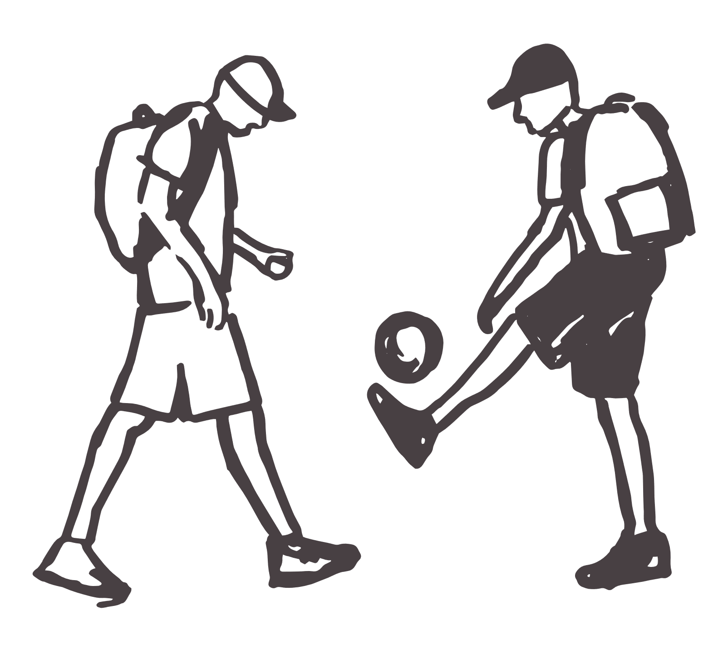
Children and young people

Slide 17
Walking rates improved for all 5-16 year olds, despite the pandemic
Pre-Covid
Once a week walking participation for children and young people (Years 1-11)
Data is for: North East Lincs
Source: Sport England, Active Lives CYP, Academic Year 2017-19 combined and 2019-21 combined Measure: Once a week walking participation for children and young people (Years 1-11)
Notes:
Sample size
17-18 863
18-19 619
19-20 581
20-21 26
Combined samples (used)
17-19 1482
19-21 607

Slide 18
Girls have the highest walking rates (when the data is combined)
Primary school age children (years 3-6) have the lowest
Once a week walking participation for children and young people (Years 1-11)
Data is for: North East Lincs
Source: Sport England, Active Lives CYP, Academic Year 2017-18 to 2020-21 combined Measure: Once a week walking participation for children and young people (Years 1-11)
Notes:
Sample size (17-21)
Girl 1011
Boy 890
Year 7-11 1515
Year 3-6 509

