Slide 1
Sport England Place needs classifications
Partnership Maps

Slide 2
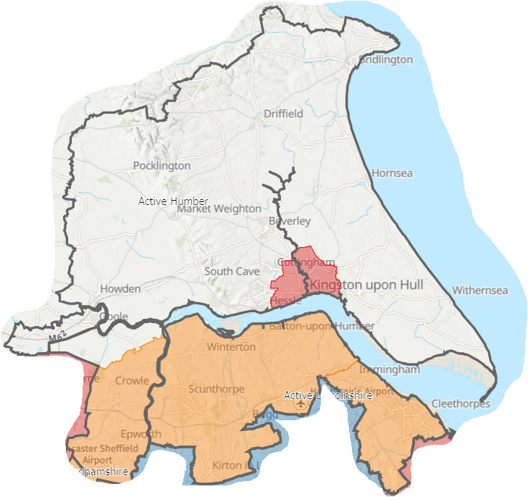
Priority Local Authorities
Source: Sport England Place Needs Classification July 23

Slide 3
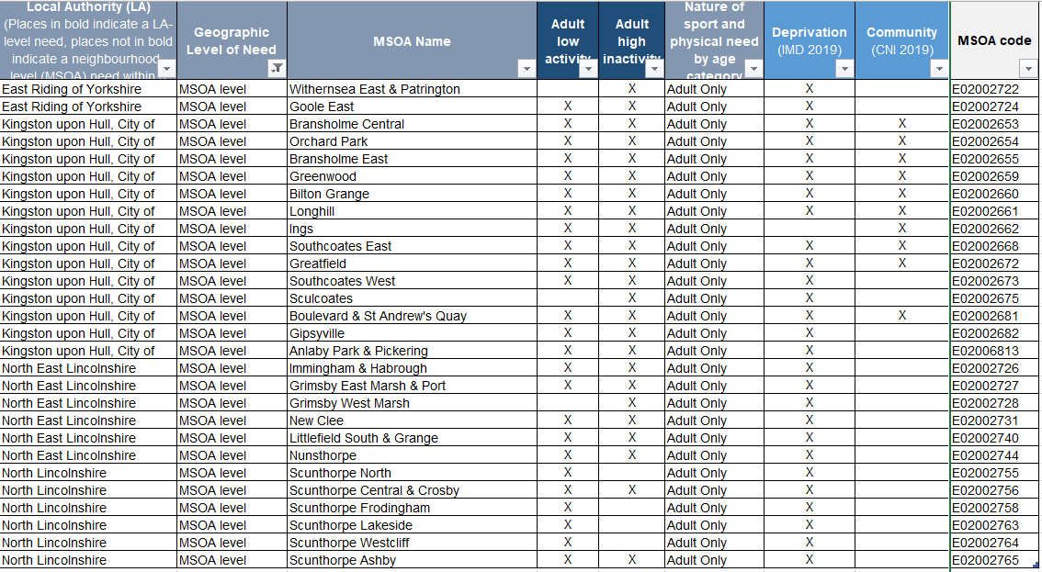
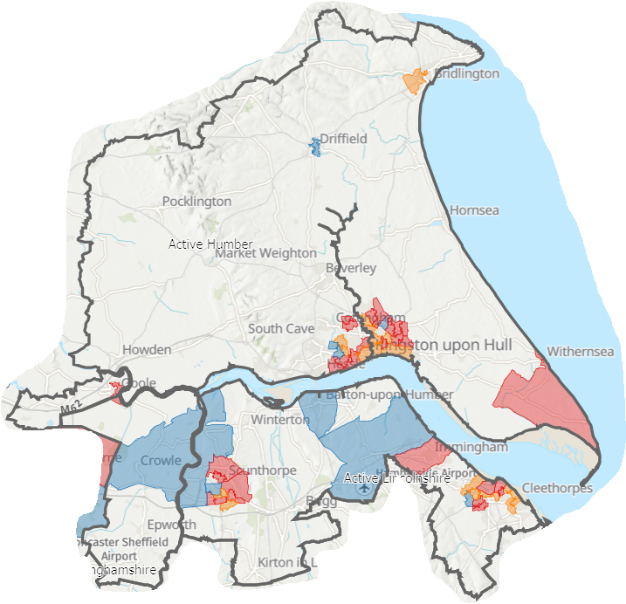
Priority MSOA’s
Source: Sport England Place Needs Classification July 23

Slide 4
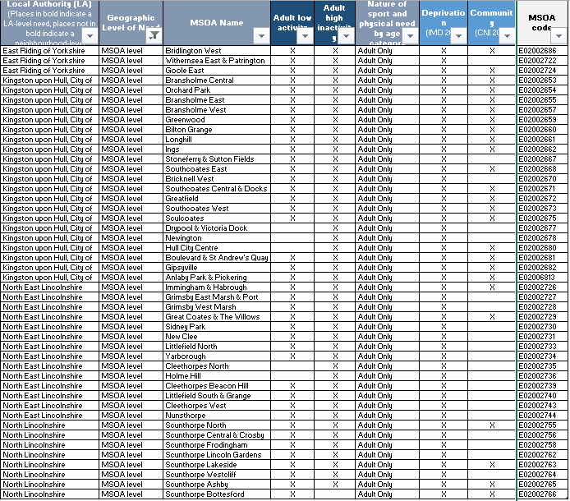
Priority MSOA’s
Source: Sport England Place Needs Classification July 23

Slide 5
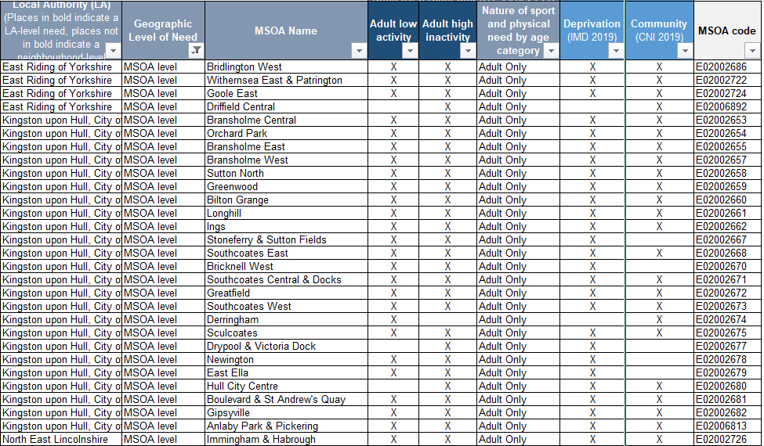
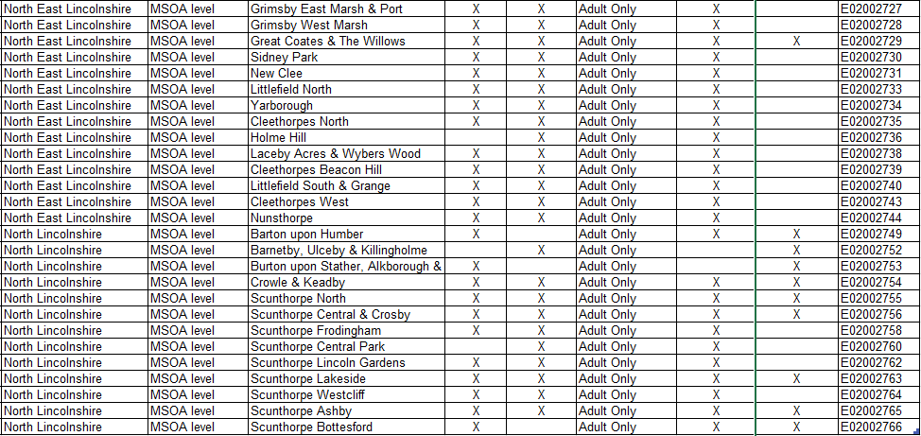
Priority MSOA’s
Source: Sport England Place Needs Classification July 23

Slide 6
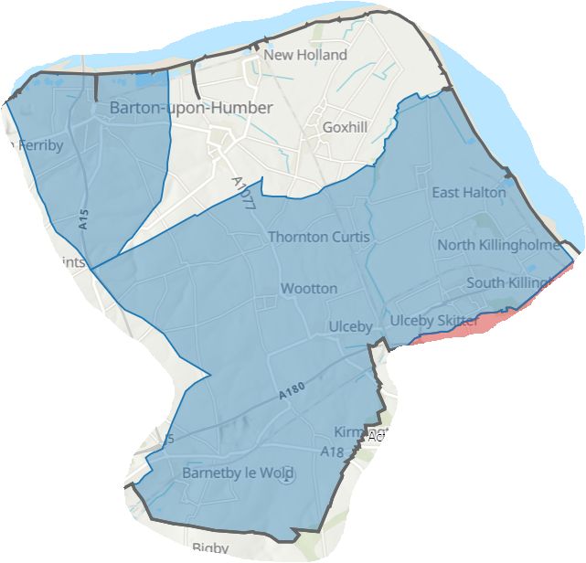
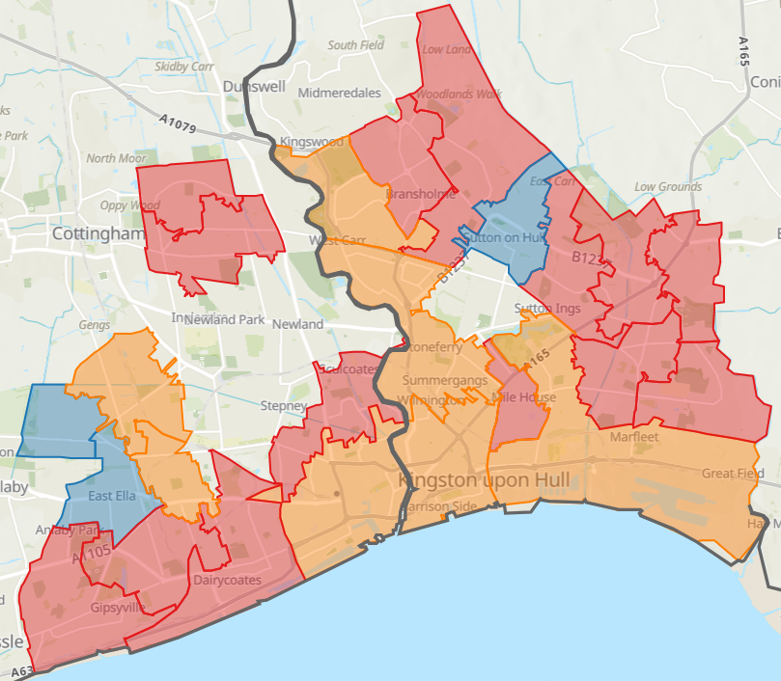
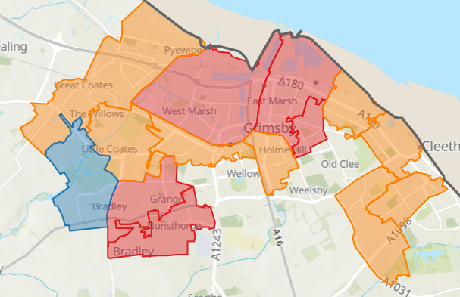
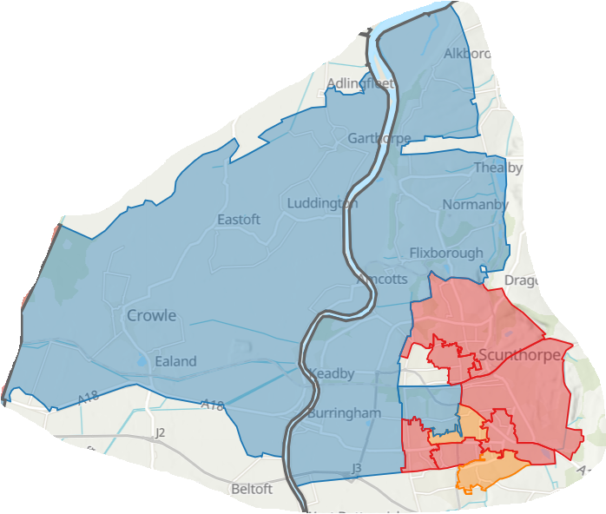
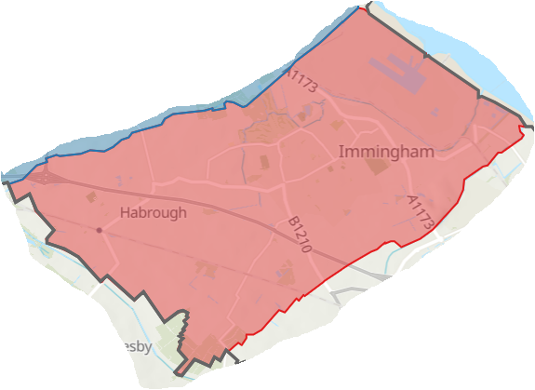
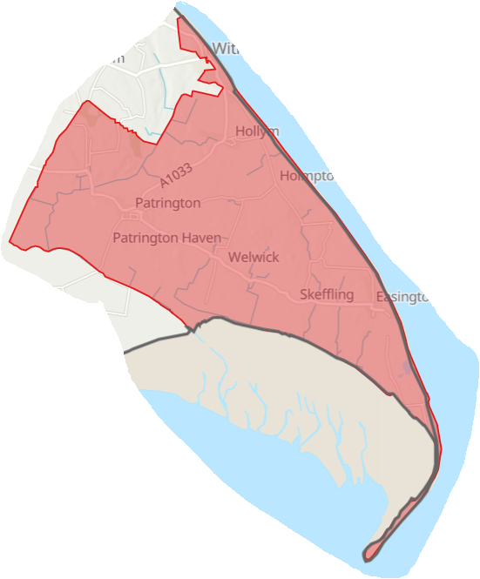
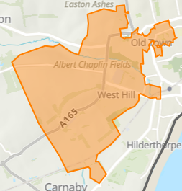
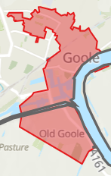
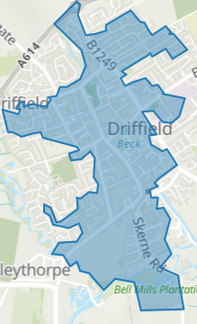
Priority MSOA’s
Hull
North East Lincolnshire
North Lincolnshire
East Riding of Yorkshire
Source: Sport England Place Needs Classification July 23

