Slide 1

An insight into adult physical activity in North and North East Lincolnshire
December 2025

Slide 2



The current landscape for physical activity in our area

Slide 3


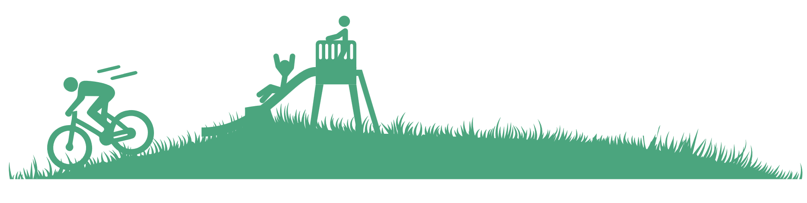
This data pack analyses physical activity over a one-year period (November 2023 to November 2024), but the findings must be interpreted within the broader context of societal changes during this timeframe.
Keep these things in mind when looking at the key messages:
Demographic shifts are ongoing
Economic pressures have intensified inequality gaps

Slide 4




What do we mean by ‘demographic shifts’?
The adult population (16+) is estimated at
271,000
27% are estimated to be aged 65 or older and showing sustained growth over time
Generally, our populations are growing, ageing and becoming more diverse.
This shift towards an ageing population in particular is moving more people into age groups we know are more likely to be inactive.
That’s 74,000
people
Continuing a steady upward trend
Sources: ONS Mid Year Population estimates for England and Wales: mid-2024

Slide 5





What ‘economic pressures’ are intensifying inequality gaps?
More than 41,000 people are now claiming universal credit
Economic inactivity among working age adults stands at almost 27%, with nearly
An increase of almost 5,000 this year that continues the rising trend
11% classified as long-term sick (around 22,000)
Income disparities continue to widen, with lower-income individuals and households experiencing disproportionate impacts from rising living costs, employment instability, and wages that haven't kept pace with inflation. This economic squeeze is pushing more people into lower income brackets – who we know are more likely to be inactive.
The number of children (aged under 16) living in relative low income families has increased this year as
An estimated 5,000 people are unemployed
part of a continuing trend, now exceeding 19,000 children.
An in-year rise of more than 300 people
Sources: Economic inactivity and economic inactivity (long term sick) are from the Annual Population Survey

Slide 7
Physical inactivity in North and North East Lincolnshire is at an all time low
Source: Sport England Active Lives Survey 2023-24 (16+)
Measure: Physical activity levels (excluding gardening)

Slide 8





29%
80,000
Source: SE ALS 2023-24 (16+) and ONS Persons by single year of age
for local authorities in England, mid-2024
Measure: Physical activity levels (excluding gardening)

Slide 9
50,000 adults
do no activity at all
(18%)
There are 28,000 people missing the intensity
(10%)
There are 2,000 people not active for long enough
(1%)
Source: SE ALS 2023-24 (16+) and ONS Persons by single year of age
for local authorities in England, mid-2024
Measure: Physical activity levels (excluding gardening)
Notes:
No activity at all – doing nothing
Missing the intensity – light only activity only
Not active for long enough – doing 1-29 minutes of activity

Slide 10
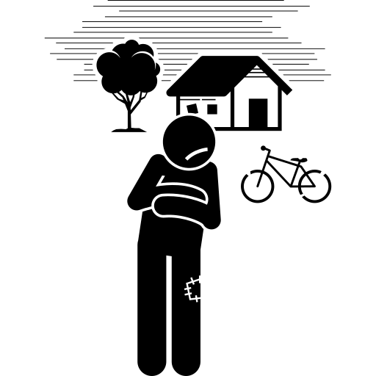



Some communities experience inactivity more than others
Gender
Inactivity fluctuates for both men and women over time
Limiting illness
Social status
Latest data shows inactivity rates have fallen for adults with a limiting illness
Inactivity in the least affluent households remains high
(NS SeC 6-8)

Slide 11
Our least affluent households are twice as likely to be inactive (NS SeC 6-8)
There is a clear inequality gap between our least and most affluent households
Source: Sport England Active Lives Survey 2015-16 to 2023-24(16+)
Measure: Physical activity levels (excluding gardening)

Slide 12
Latest data shows inactivity rates have fallen for adults with a limiting illness
However, inactivity is similar to baseline and there is still a clear gap between adults with a limiting illness and those without
Source: Sport England Active Lives Survey 2015-16 to 2023-24 (16+)
Measure: Physical activity levels (excluding gardening)

Slide 13
Inactivity fluctuates for both men and women over time

Slide 14

There is a peak in inactivity levels for adults aged 25-44
Age range
Source: Sport England Active Lives Survey 2023-24 (16+)
Measure: Physical activity levels (excluding gardening)

Slide 15
Women have notably higher inactivity levels than men between the age of 25 and 54
Age range
Source: Sport England Active Lives Survey 2023-24 (16+)
Measure: Physical activity levels (excluding gardening)

Slide 16

Where we live makes a difference
Inactivity is higher in our more deprived communities…
…compared to our least deprived communities
Source: Sport England Active Lives Survey 2023-24 (16+)
Measure: Physical activity levels (excluding gardening)

Slide 17



Inactive rates are higher for those outside of the workforce (economically inactive)
Source: Sport England Active Lives Survey 2023-24 (16+)
Measure: Physical activity levels (excluding gardening)
Notes:
Definition: ‘Long term sick or disabled’
This demographic group are counted as ‘outside of work’ or ‘economically inactive’ because they are long term sick or disabled. The percentage in this chart represents the proportion of those who are inactive.

Slide 19




When we look at activity levels, we can see how having 2 or more factors can dramatically reduce our ability to be active
Particularly when compared to those with no factors
Physical activity levels
Source: Sport England Active Lives Survey 2023-24 (16+)
Measure: Physical activity levels (excluding gardening)

Slide 22
Includes walking as a way to get from one place to another, such as the shops work or visiting friends*
Includes team, water, combat and winter sports, swimming, athletics, golf, horse riding and gymnastics
Includes all other types of walking, dog walking, rambling and Nordic walking or just going for a stroll*
Includes gym activities (fitness machines and classes), weights, boxing and interval sessions
Gardening is included in this section
Includes leisure and travel, track, road and mountain biking or racing, exercise bike or cycle class
Covers all types of dance including artistic and creative dance (ballroom, ballet, contemporary etc)

Slide 23
Average overall minutes per person per week
Time spent being active has fallen over time
Source: Sport England Active Lives Survey 2015-16 to 2023-24 (16+)
Measure: Minutes of Physical activity per week)

Slide 24




We spend well over half our active time walking or gardening
Source: Sport England Active Lives Survey 2023-24 (16+)
Measure: Minutes of physical activity per week
Notes:
Gardening is notably higher than in other areas, but walking for travel is lower

Slide 25
80% of our active minutes are outside
Source: Sport England Active Lives Survey 2023-24 (16+)
Measure: Minutes of physical activity per week
Notes:
This is higher than we’ve seen in most other partnerships

Slide 26
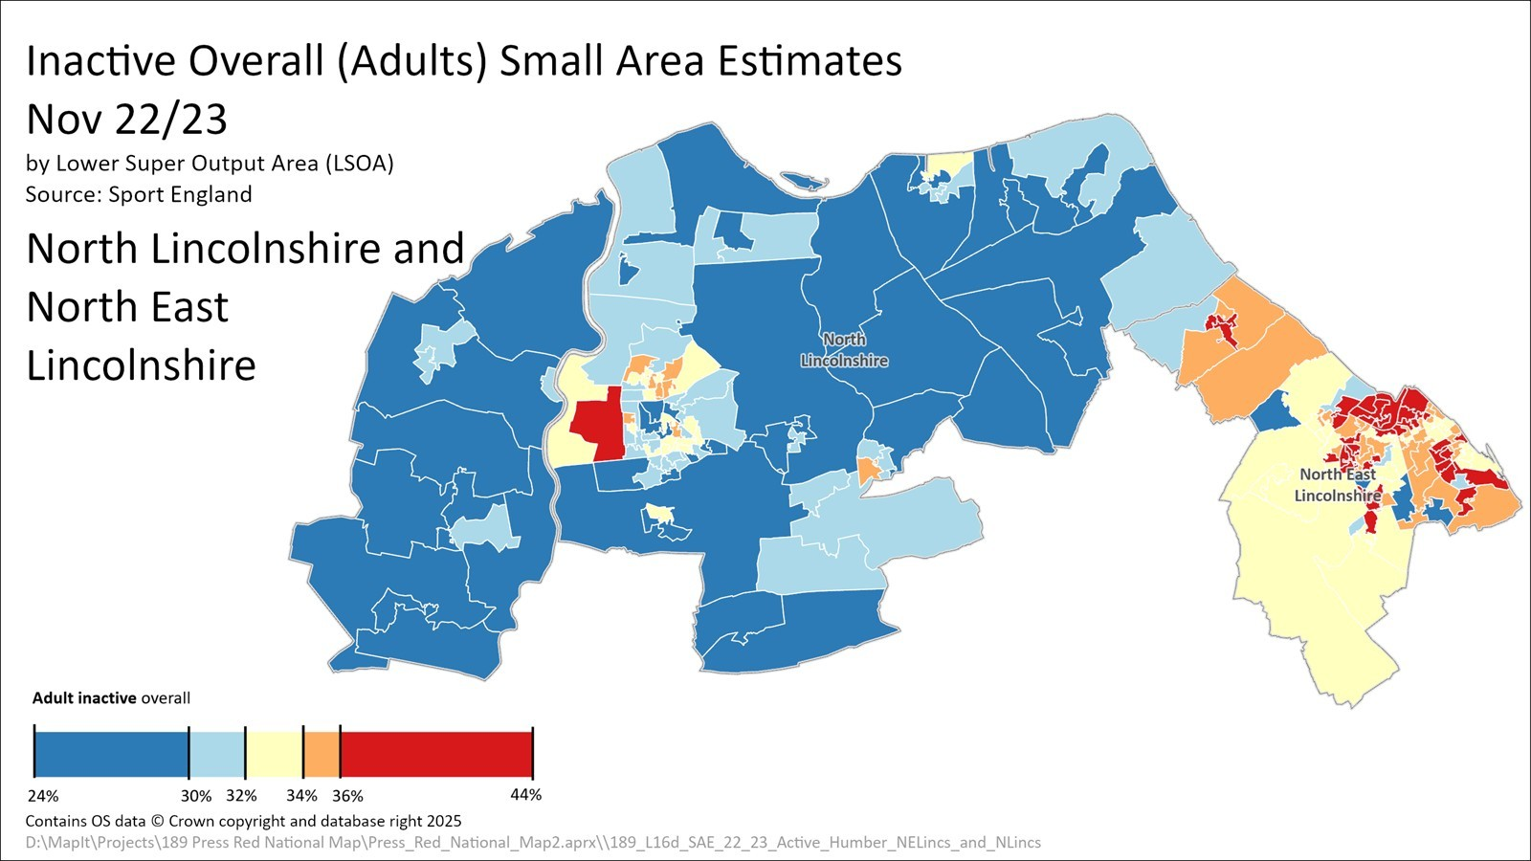

Slide 28
 | North and North East Lincolnshire | England
No limiting illness | 77% | 80%
Limiting illness | 23% | 20%
16-34 years | 26% | 30%
35-54 years | 30% | 32%
55-74 years | 32% | 27%
75+ years | 12% | 11%
NS SeC 1-2 | 24% | 33%
NS SeC 3-5 | 27% | 27%
NS SeC 6-8 | 43% | 32%
Asian | 2% | 9%
Black | 0% | 4%
Mixed | 1% | 2%
White British | 91% | 75%
White Other | 5% | 8%
Working full or part time | 56% | 61%
Unemployed | 3% | 3%
Not working | 41% | 36%
Census provides an insight into the demographic makeup in our area compared to England
Notes:
N & NE Lincs England
Male 49% 48%
Female 51% 52%
NS SeC 9 5% 8%
Minority ethnic group 9% 25%
Other ethnic group 1% 2%

Slide 29
For further information please contact us at:
scott@pressred.co.uk or liz@pressred.co.uk

